Slide 1


What are you most WORRIED about when your child is ONLINE?
Notes:
ASK: Find out what parents are currently worried about
TELL: Despite the positive finding that over seven in ten (72%) 8-17-year-olds who use messaging/social media sites or apps feel safe when using these apps/online sites, either all or most of the time, the online space is a risky environment for children.

Slide 2
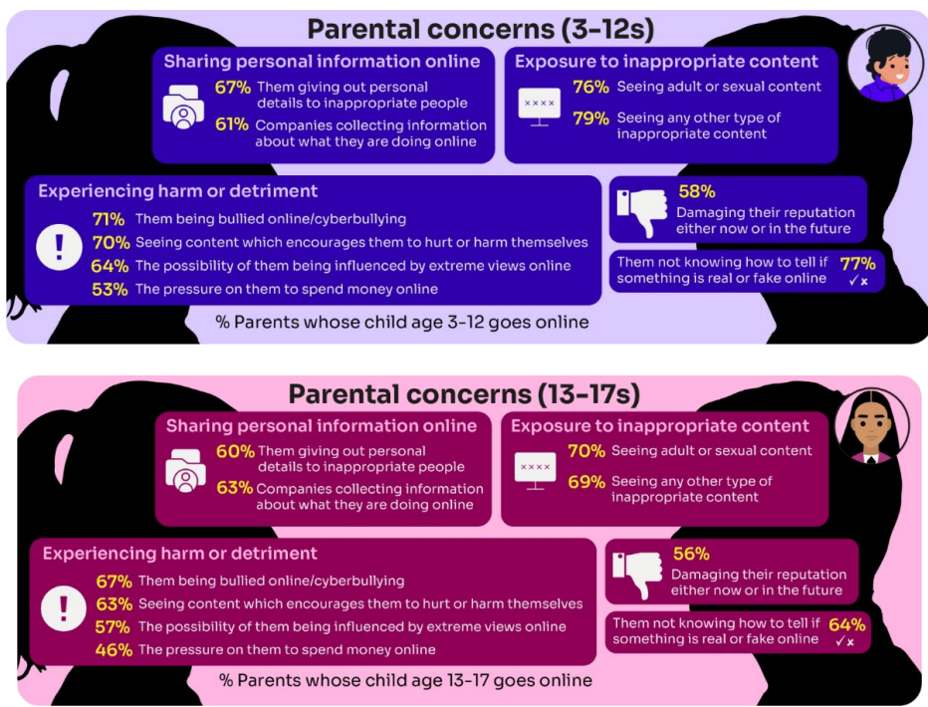
Summary of parental concerns (3 – 17 yr-olds)
Source: Children and parents: media use and attitudes report 2025
Notes:
Many parents indicate that they have concerns around various aspects of their children’s online activities.
The primary worry of all parents of online 3-17s continues to be potential exposure to age inappropriate content - three-quarters of parents said they were either fairly or very concerned about their child seeing content which is not appropriate for their age (76%) and the same proportion were concerned about them seeing ‘adult’ or sexual content (74%).
72% were concerned their child not knowing how to tell if something is real or fake online.
Seven in ten (69%) parents fear their child might be bullied online,
A similar proportion (68%) are worried about them seeing content that encourages them to hurt themselves.
61% of parents are concerned about their child being influenced by extreme views,
51% worry about the pressure to spend money online.
Unsurprisingly, there are many concerns which are more prominent among parents of younger (3- 12-year-old) children who go online.:
For example, a higher proportion of these parents compared to their counterparts (parents of teenagers) are concerned about their child being exposed to age inappropriate content (79% vs 69%), their child not being able to tell what is real or fake online (77% vs 64%), their child seeing content which encourages them to harm themselves (70% vs 63%), the 36 child giving out personal details to inappropriate people (67% vs 60%) and the possibility of their child being influenced by extreme views online (64% vs 57%).

Slide 3



YOU don’t need to be an EXPERT … be a PARENT
It’s your choice – don’t let others dictate when the right time is to use tech.
Stay involved – make time to communicate, talk about what they are doing. What do they enjoy? What makes them laugh?
Don’t quiz them – have regular conversations. What's their favourite app? What is the best site to learn new things from?
Join in – watch them play a game and join in. Who are they playing with? Do they know the other players?
‘Show me how…’ – ask their advice to help you with your privacy settings, who you should add as a friend, are there any risks?
Lead by example – children learn as much from watching as they do from being told not to do something, so model good behaviour
Reassure them – tell them that they won't get in trouble and that you are always there to help
Notes:
ASK – What do you do that works well? Share good practice
REMIND - You do not need to be a tech expert to help your child with staying safe online. It’s ultimately about communication and being proactive.

Slide 4
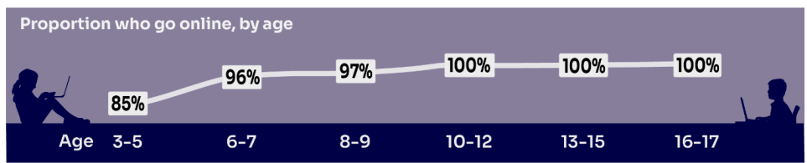

HOW MUCH DO YOU KNOW about your child’s life online?
Almost all children (96%) aged 3 – 17 went online in 2024, highlighting the centrality of the internet in their lives:
    Younger children commonly use tablets to go online
    Older children are more likely to use mobile phones
Source: Children and parents: media use and attitudes report 2025
Notes:
TELL:
We will be looking at 3–17-year-olds patterns of media use, how they access different sources of media online, and the types of online activities they are participating in. This includes their behaviours and habits in terms of viewing, playing, learning, and interacting
Almost all children from aged 5yrs (96%) went online in 2023, highlighting the centrality of the internet in children’s lives.
And we mustn’t forget that being online does create a lot of opportunity and joy for most of us. So, let’s think about how we can minimise risk and reduce their exposure to harm.

Slide 5

Does your child have their OWN MOBILE PHONE? If so, is it a SMART PHONE?
What AGE do you think is appropriate?
Source: Children and parents: media use and attitudes report 2025
Notes:
By the age of 11 nine in ten (91%) children aged 3-17 own their own mobile phone. in the period before they progress to secondary school, children become more likely to use a mobile phone to go online, while younger children (those aged 10 and under) are more likely to use a tablet.
TELL - A common debate is about the age at which children should be able to use smartphones. These are mobile phones that can access the internet and have apps installed on them. Some parents have opted for non-smart’ phones, which are mobiles that usually only have text and call capabilities.

Slide 6


SMARTPHONE or ‘NON’-SMART / BRICK phone?
REMEMBER IT’S YOUR CHOICE
Every child and situation is unique,
and you are best placed to know their needs
Internet access
Social media, apps and games
Notifications
Anytime connection
Parental controls
NO internet access
Some games
Anytime phone calls and texts
Limited parental controls
Notes:
ASK THEM TO CONSIDER:
How will they reduce any risks?
What does their child need the mobile for? Is it simply to stay in touch with you - then a ‘non-smart’ phone might be enough. But if you want them to access homework or learning on their mobile, then a smartphone might be better.
How you can help them child learn the basic skills to use it safely e.g. to send a message, take part in a group chat, manage their timings etc. Children need our support with developing these skills. You wouldn’t give your child a knife without guidance and support, similarly a phone can cause harm and so need to think about this.
Whatever they decide, communication is key - involve the child in the process to establish shared expectations.
Remember to set up parental control settings or use a parental controls app to help them stay safe.

Slide 7

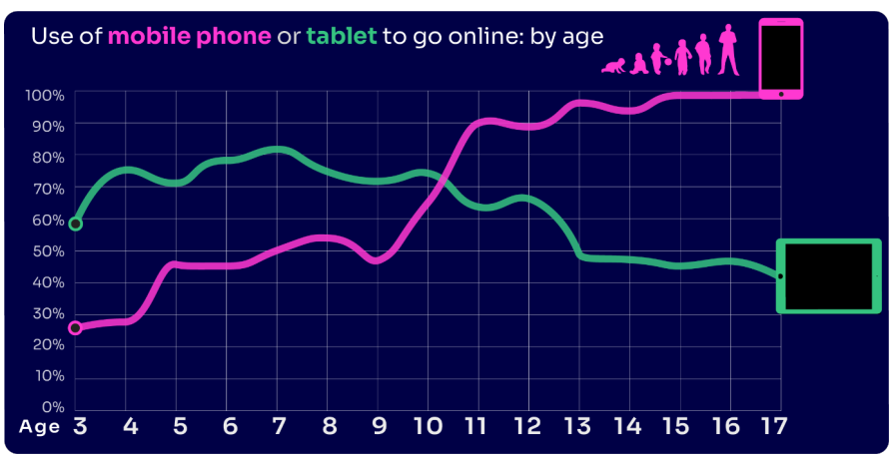
By age 11, nine in ten children own their own mobile phone, distinct from using a family device
This correlates with transition from primary to secondary school.
Source: Children and parents: media use and attitudes report 2025
Notes:
As in previous years, the point at which it becomes more likely that a child will go online using a mobile rather than a tablet closely correlates with the age at which mobile phone ownership among children becomes almost universal.

Slide 8
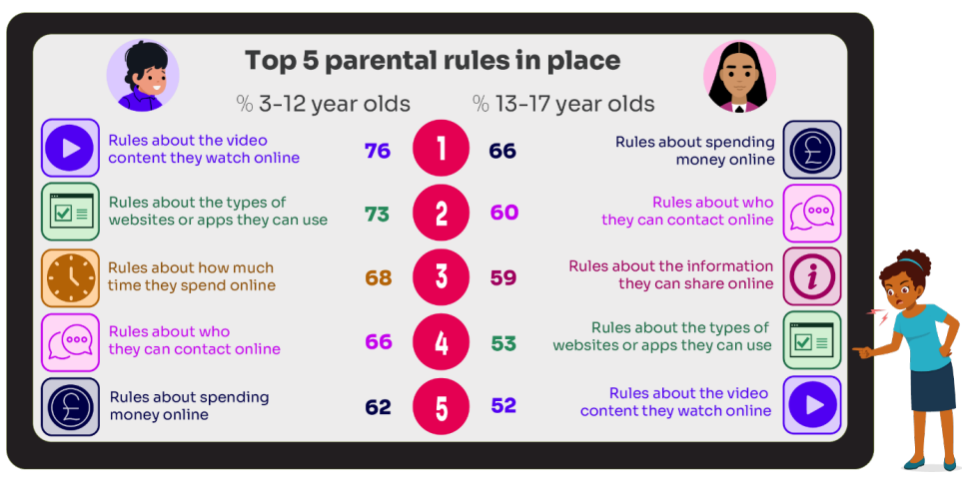
What RULES do YOU SET about being online?
What do you do that WORKS?
While parental concerns in some areas have increased considerably, their enforcement of rules appears to be diminishing, partly due to parents’ resignation about their ability to intervene in their children’s online lives.
Source: Children and parents: media use and attitudes report 2025
Notes:
ASK: What rules do you set for your children? How confident are you in implementing them?

Slide 9

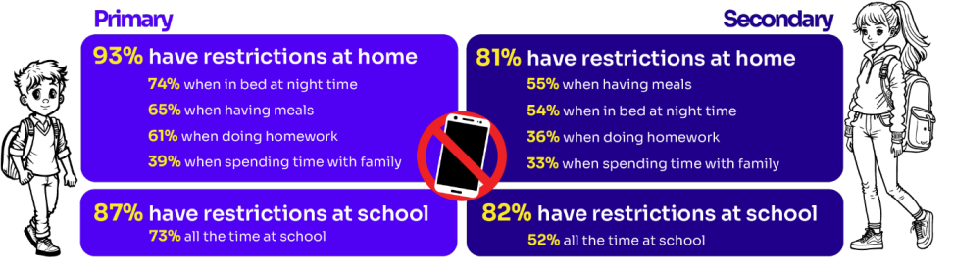
Do you RESTRICT their MOBILE PHONE USE?
If so, have you found it CHALLENGING?
Source: Children and parents: media use and attitudes report 2025
Notes:
ASK: What restrictions do you set for your children? How confident are you in implementing them?
More than eight in ten (83%) 8-17s in this group say there is at least one time when they cannot use their phones at home. Looking at specific restrictions when a child in this group is at home, nearly six in ten (58%) of 8-17s who go online via their phone say they are not allowed to use their phones when they are in bed at night, with a similar proportion (57%) reporting that they are not allowed to do so while having meals. Younger children in this group are more likely than older ones to report having each of these restrictions in place

Slide 10

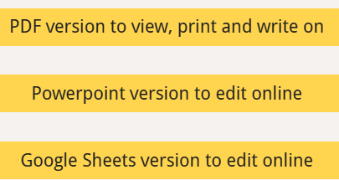
Why not have a family agreement to:
clarify what is allowed...or not
establish ground rules like no phones at the table or in the bedroom at night-time
agree shared expectations to reduce arguments and keep everyone safe & healthy
Download it at parentsafe.lgfl.net/digital-family-agreement
Notes:
TELL:
To help facilitate this, LGfL have created a free digital family agreement that parents could sit down and populate with all family members to agree what is and is not allowed within their family around tech use. This includes parents! WE as parents also need to role model good behaviour.

Slide 11
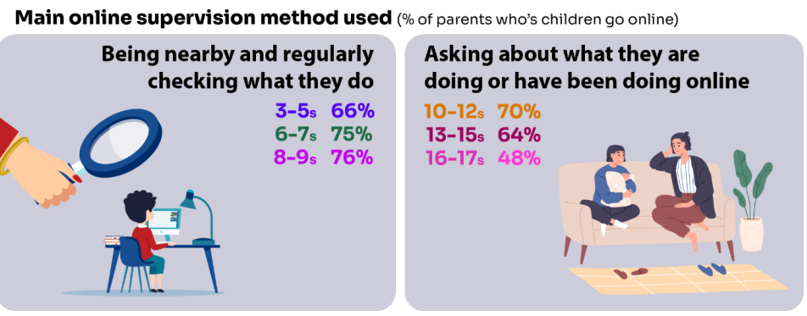

Do you SUPERVISE your child’s online activity? HOW?
Source: Children and parents: media use and attitudes report 2025
Notes:
TELL - The two most commonly-employed types of parental supervision among parents of 3-17s are to:
ask their child about what they are or have been doing online (59%), and
be nearby and regularly checking what their child does (55%).
Of course, this varies as the child gets older and more independent, as parents decreasingly monitor their child’s online life

Slide 12


Have you set up parental CONTROLS/PRIVACY SETTINGS for ALL DEVICES and NETWORKS?
Controls need to be set up on both the broadband connection AND each individual device
These do not come as standard so it’s worth checking
They are important because they allow you to:
  Block and filter upsetting or inappropriate content or sites
  Plan what time and how long your child can go online for
Notes:
TELL – it is important that these controls are set up on BOTH the broadband connection AND each individual device
About seven in ten (73%) parents of all 3-17-year-olds use at least one type of technical tool or control to manage their child’s access to online content; parents of 8-11-year-olds are more likely than those of older children to use at least one of these tools (84% vs 70% of parents of 12-15s and 54% of parents of 16-17s respectively). The most commonly-used technical tool used, across all parents of 3-17s, were parental controls built into the device by the manufacturer, e.g. Windows, Apple, Xbox, PlayStation etc. (32%). (Ofcom 2024)

Slide 13
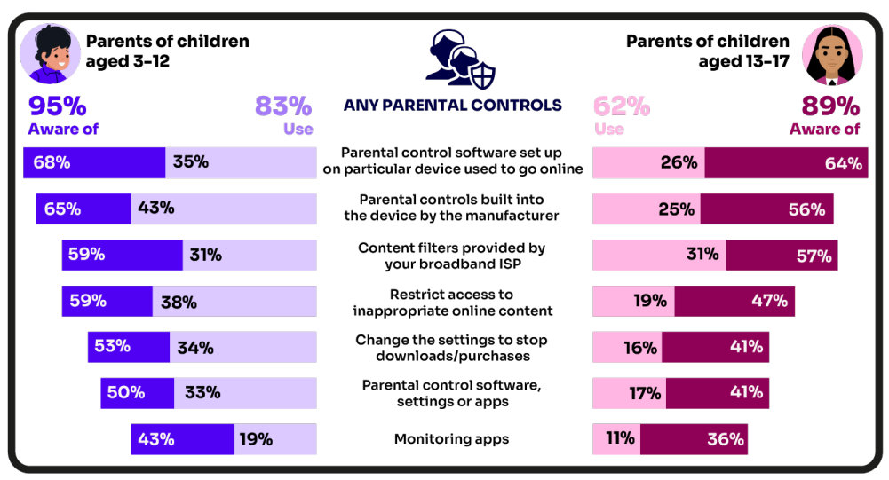
Are you AWARE of these PARENTAL CONTROL TOOLS?
Which ones have YOU USED?
‘I prefer to supervise my child’s online use by talking to them about setting rules’
(39%)
Source: Children and parents: media use and attitudes report 2025
Notes:
There is a high awareness of technical control tools among parents, BUT many are choosing not to use them
ASK – Why do you think this is the case?
TELL – it’s not as complicated or scary as you think. Let’s look at some top tips and resources to support you.
Parents of younger children are more likely than those with older children to use at least one type of technical tool or control to manage their child’s access to online content, with 83% of parents of 3-12s using at least one of these tools compared to 62% of parents of 13-17s.
Among all parents, the most frequently-used technical tool or control, out of the options presented to them, continues to be parental controls built into the device by manufacturers (such as Windows, Apple, Xbox, PlayStation etc.).
Parents of 6-7s in particular are more likely to use this type of control, with 50% of these parents saying they use these in 2024, compared to 36% in 2023.
Parents of 8-9- year-olds are more likely than last year to use apps installed on their child’s phone to monitor app usage. This year, 22% of these parents used such apps, up from 10% in 2023.

Slide 14

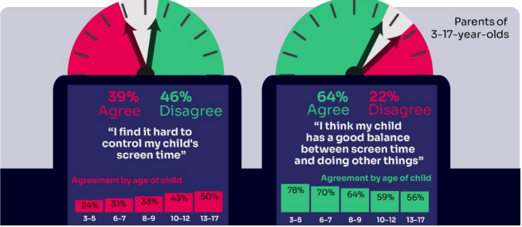
WORRIED about their SCREENTIME? How do you MANAGE this?
Know HOW LONG YOUR CHILD SPENDS online daily?
“I’ve been told is that when I get off my screen, I’m less fun to be around.
..And like I can also feel angrier for like no reason.”
Children spent an average 3 hours 5 minutes per day accessing the internet via smartphones/tablets/computers
Four in ten (39%) parents of children aged 3-17 report finding it hard to control their child’s screentime
Source: Children and parents: media use and attitudes report 2025
Notes:
Four in ten (39%) agreeing that they find it hard to control their child’s screentime, increasing as the child gets to teenage years, with 33% of parents of 3-12s compared to half (50%) of parents of 13-17s agreeing with this statement. A similar sentiment is seen when we ask parents whether they think their child has a good balance between screentime and doing other things. Overall, just under two-thirds (64%) of all parents agree that they do, but the proportion is lower among parents of teenagers; 56% of parents of 13-17s agree that their child has a good balance, compared to 68% of parents of 3-12s.

Slide 15

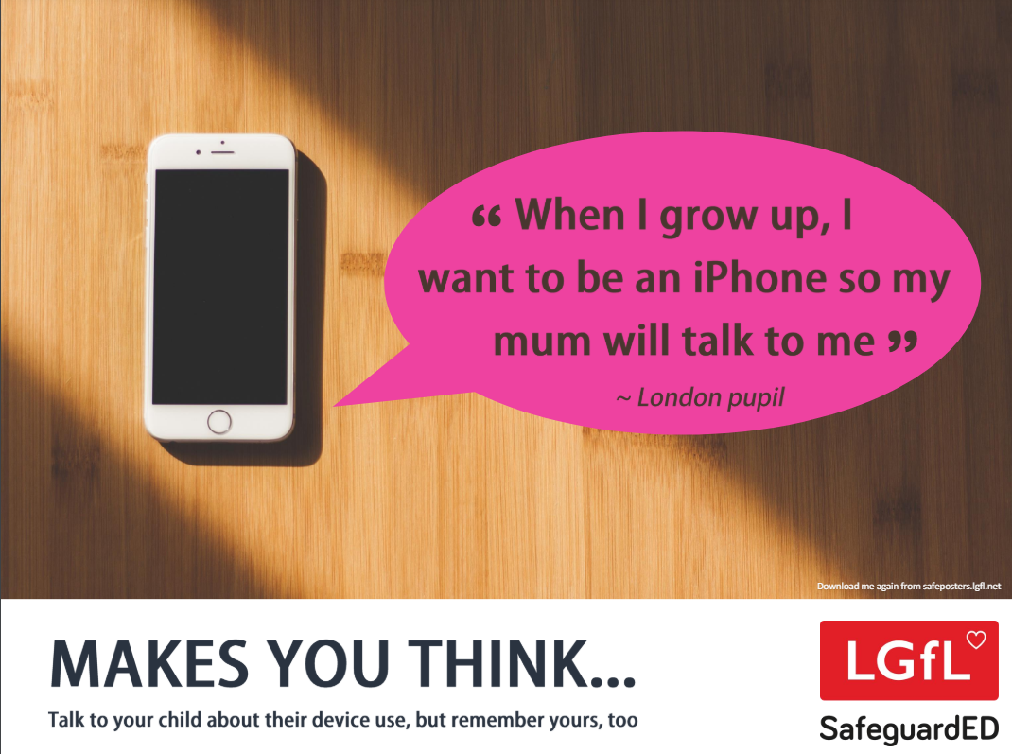
How does your child feel about YOUR SCREENTIME vs THEIRS?
52% of 8-11s feel that their parents’ screentime is too high
33% of 8-17s feel that their own screentime is too high
Source: Children and parents: media use and attitudes report 2025
Notes:
Of the third of online 8-17s who think their screentime is too high, just over half (52%) also think their parents’ screentime is too high, compared with the 15% who do not think their parents screentime is too high, and a quarter (26%) who are not sure.
REMIND – it’s important to model good behaviour when it comes to device use, as children will follow our example. The same goes for ‘sharenting’ (see slide 22)

Slide 16

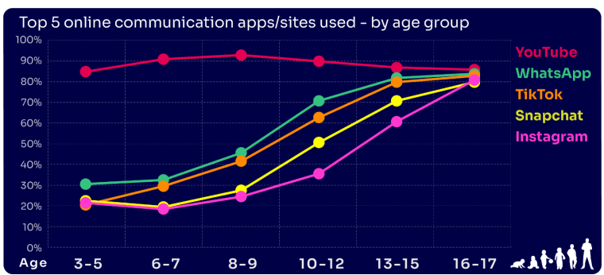
Are you FAMILIAR WITH THE APPS and GAMES your child is on?
YouTube is the most popular, but the appeal of many social media platforms varies by age
The two most popular apps for 3 – 7 yr-olds are WhatsApp (2 in 10) and Snapchat (3 in 10)
The proportion of 8-9s with an Instagram profile increased from 8% in 2023 to 14% in 2024
13-17s are most likely to have profiles on WhatsApp
(62%), Snapchat (62%) or TikTok (61%)
Source: Children and parents: media use and attitudes report 2025
Notes:
YouTube continues to be universally popular, and the appeal of other social media platforms increases with age . nearly half (48%) of 16-17s use all of the top five apps/ sites that we asked about (YouTube, WhatsApp, TikTok, Snapchat and Instagram).
REMIND – your children need to be 13+ to use these platforms (See slide 39)

Slide 17

WHY DOES THIS MATTER?
Young people can get around age restrictions on apps and websites, increasing the risk of them coming to harm online
Addictive algorithms can make it harder to take a break and maintain a healthy balance between time on and offline
Algorithms can also target content similar to what you’ve already selected/liked/shared
This can prevent you from finding new ideas and perspectives, create misinformation and reinforce stereotypes
Notes:
ASK – What kinds of risks do you think children could be exposed to? Can you give examples? (See slide 48 for a summary of related risks)

Slide 18

What might they NOT BE TELLING YOU?
Eight in ten (81%) of all children aged 8-17 use at least one social media app/site for following friends, people and organisations, reading, liking or sharing content.
Nearly six in ten (56%) 8-17s use multiple profiles on at least one social media platform.
(23%) said it was because one account was just for parents/family to see
15% said one account was for the ‘real me’ and another contained edited/filtered posts or photos
Source: Children and parents: media use and attitudes report 2025
Notes:
TELL - This demonstrates that at least some children feel the need to present distinct aspects of themselves on social media, depending on the audience.

Slide 19
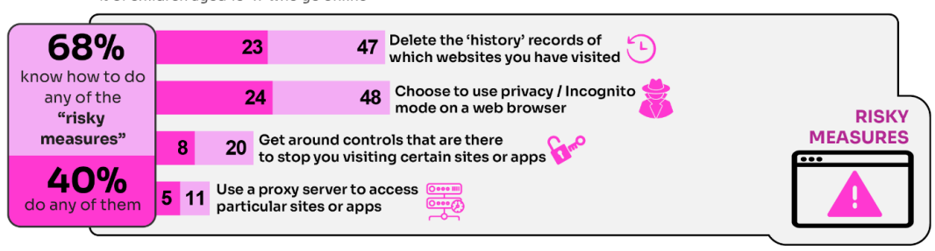
WHY is this ‘RISKY’?
40% had engaged in ‘risky’ behaviour!
Source: Children and parents: media use and attitudes report 2025
Notes:
TELL - This behaviour is considered ‘risky’ because they enable the child to conceal their online activity, preventing a parent or appropriate adult to ensure they are keeping safe online.

Slide 20
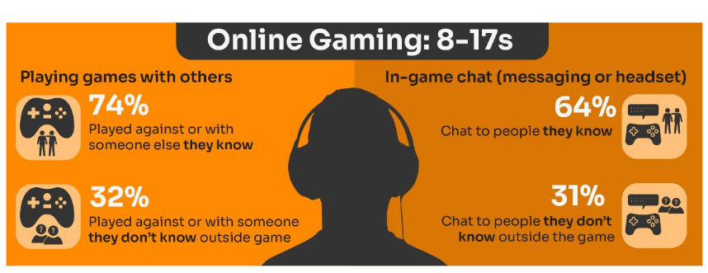
Do you know the DIFFERENCE between an ‘ONLINE’ FRIEND and a real one? How does this differ from your CHILD’S VIEW?
Are you familiar with who they are in contact with whilst playing games?
Have you asked about the chat facility?
Do you know the content and age restrictions for these games?
72%
63%
31%
31%
Source: Children and parents: media use and attitudes report 2025
Notes:
TELL:
Children often use online gaming as a tool to communicate with their peers, with 64% of 8-17s who game online chatting through the game with friends and/or people they know in real life.
However, 31% of children who game online, communicate with strangers as well.
A higher proportion of these children now play shooter games. This may raise concerns about how age appropriate the games favoured by some younger children actually are.
While communication via games is a valuable social tool for many children, it can sometimes leave them vulnerable to unwanted interactions. This year (12%) of all children aged 8-17 said someone had been nasty/hurtful to them through an online game

Slide 21
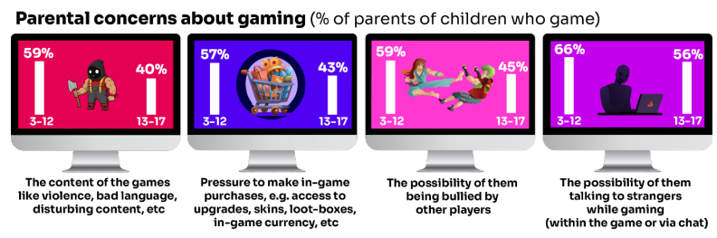
What are YOU most WORRIED about when it comes to GAMING?
Source: Children and parents: media use and attitudes report 2025
Notes:
TELL:
The most commonly cited concern among parents of 3-17s whose child games was the possibility of their child talking to strangers while gaming, either within the game or via the chat function (62%).
This was followed by the possibility of their child being bullied by other players (54%), the content of the games the child plays – i.e. violence, bad language, disturbing content etc. (52%), and the pressure on the child to make in-game purchases e.g. for things like access to upgrades, skins, loot-boxes, in-game currency or other rewards (52%).
Overall, parents of younger children are more likely than parents of teenage children (13-17s) to be concerned about these possibilities

Slide 22


Four in ten under-13s have a profile on social media apps or sites…
YouTube/YouTube Kids (44%)
WhatsApp (23%)
TikTok (23%)
The proportion of 8-9s with an Instagram profile increased from 8% in 2023 to 14% in 2024
Despite there being a minimum age requirement of 13 for using most social media apps, over half of
3-12-year olds (55%) were reported as using at least one social media app or site, an increase on last
year, when 51% of these children did so.
Source: Children and parents: media use and attitudes report 2025

Slide 23
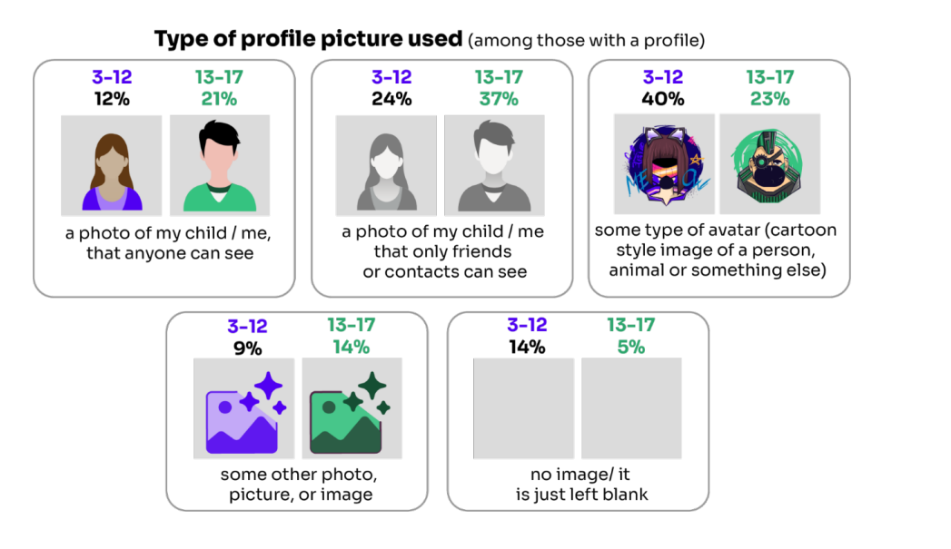
Do you know what they SHARE?
16% of children who have a social media profile include a photo of themselves which anyone can see
Source: Children and parents: media use and attitudes report 2025

Slide 24
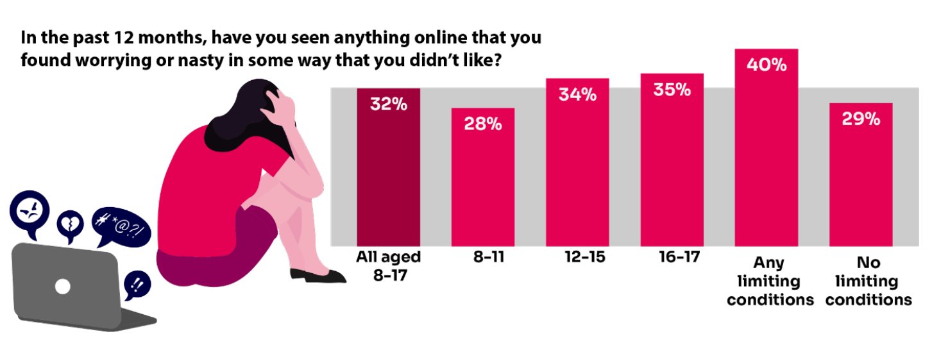
Summary of children’s negative experiences:
BUT Only 20% of parents report their child telling them about this in the same time frame.
Source: Children and parents: Media use and attitudes report
Notes:
TELL:
A third of 8-17-year-old children are being exposed to content online that they find worrying or nasty, but only 20% of parents report their child telling them they had seen something online that scared or upset them in the same time frame.
The likelihood of children seeing this type of content increases with age - just over a third of 12-17s say they have been exposed to this type of content in the past year (34%) compared to 28% of 8-11-year-olds.
NB. Children aged 8-17 who live with at least one impacting condition (e.g. illness, disability, SEND) are more likely than those without such a condition to say they have seen this type of content (40% vs 29%). This indicates that particular groups of children may be more vulnerable than others to being exposed to potentially harmful content.

Slide 25
Current issues that schools are dealing with right now Include:
An internet made for adults accessible to children
Pornography
Threats to harm family members if they don’t…
Gen AI
Bullying
Nudes pressure to share and receiving them
Lack of role models
Grooming Exploitation
Radicalisation
Violent misogyny
Self-harm suicide content
Fake accounts profiles
Disinformation Misinformation what can you believe?
Sexual extortion
Notes:
Talk through the ones most relevant to your school and ask parents if they are familiar with some of these terms, e.g. Gen AI, sexual extortion, misogyny
TELL – we will go over some of these in more detail, but they can find out more at parentsafe.lgfl.net

Slide 26
So what are the RISKS?
content: being exposed to illegal, inappropriate, or harmful content, for example: pornography, racism, misogyny, self-harm, suicide, antisemitism, radicalisation, extremism, misinformation, disinformation (including fake news) and conspiracy theories.
Updated to clarify misinformation, disinformation and conspiracy theories are safeguarding harms
contact: being subjected to harmful online interaction with other users; for example: peer to peer pressure, commercial advertising and adults posing as children or young adults with the intention to groom or exploit them for sexual, criminal, financial or other purposes
conduct: online behaviour that increases the likelihood of, or causes, harm; sharing and receiving explicit images (e.g. nudes and semi-nudes and/or pornography and online bullying
commerce: risks such as online gambling, inappropriate advertising, phishing and or financial scams
Keeping Children Safe in Education
Notes:
TELL - The 4 Cs of online safety is a useful way to identify online safety risks for children (content, contact, conduct and commerce)
We will now take a look at some of these in more detail over the next few slides

Slide 27
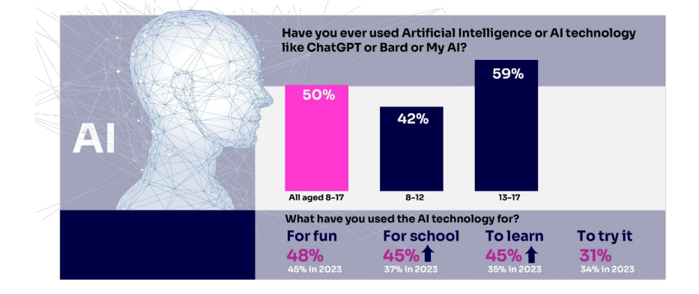
Half of children say they use artificial intelligence (AI) tools
Source: Children and parents: media use and attitudes report 2025
Notes:
ASK – What does Gen AI mean to you?
TELL -Al systems are designed to complete tasks and solve problems that in the past would have needed human thinking. Generative Al (genAl) allows us to ask Al to create things for us, such as photos, music, emails, and recipes and is able to work with and process vast amounts of information to complete the task it is set. GenAl can be found on many different platforms, apps and websites.. Children and young people often use Gen AI for:
Asking questions
Studying and revision
Getting advice
Planning
Coding
Being creative through art or music
For ideas and inspiration
Drafting messages and emails
Analysing data
EXPLAIN: Lots of talk about pupils using it to cheat in coursework but perhaps not as much about some of the very real safeguarding risks
Let’s not forget many gen-ai apps are publicly available to EVERYONE. Many mainstream Social Media and Education Platforms have chatbots or gen-ai functions too!
An Internet Matters report warns vulnerable children are most at risk, with the survey finding 71% of vulnerable children are using AI chatbots. A quarter (26%) of vulnerable children who are using AI chatbots, say they would rather talk to an AI chatbot than a real person, and 23% said they use chatbots because they don’t have anyone else to talk to.
SHOW – Childnet’s Parent Leaflet and scroll through key strategies and pointers to help keep children safe: - https://www.childnet.com/wp-content/uploads/2025/03/Childnet-Cheat-Sheet-GenAI.pdf

Slide 28
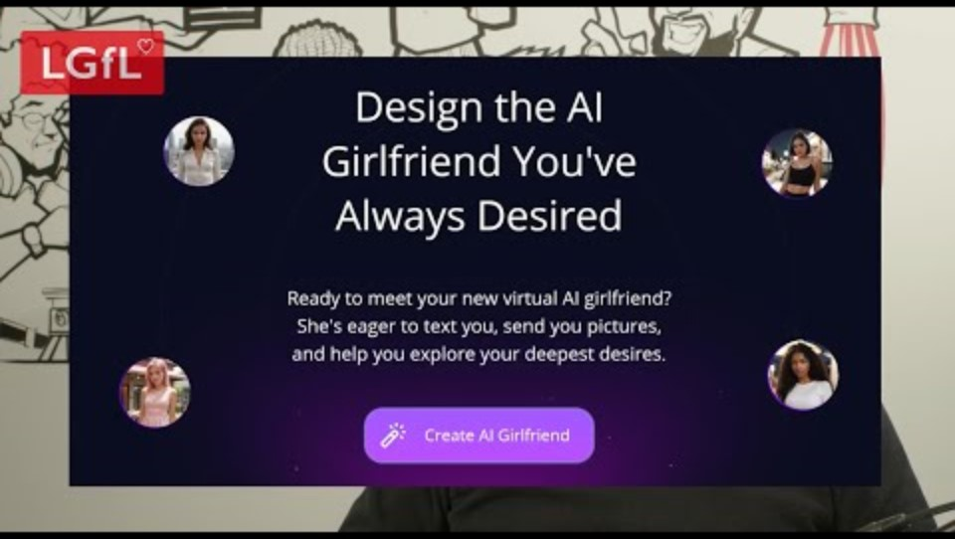
Generative AI – what do you think the risks are ? are?
Notes:
TELL - Children and young people are being exposed to online harm with new generative AI (gen AI) tools which are now everywhere online! These include sexbots, AI girlfriends, nudifying sites, etc. If you think 'my child wouldn't see these things', you may think again when you hear more.
PLAY VIDEO: https://www.youtube.com/watch?v=XEsHwss2x8E&list=PLaIzX4UgxCRl8e_36R79fqLp_qt1imm4D&index=3&t=203s

Slide 29
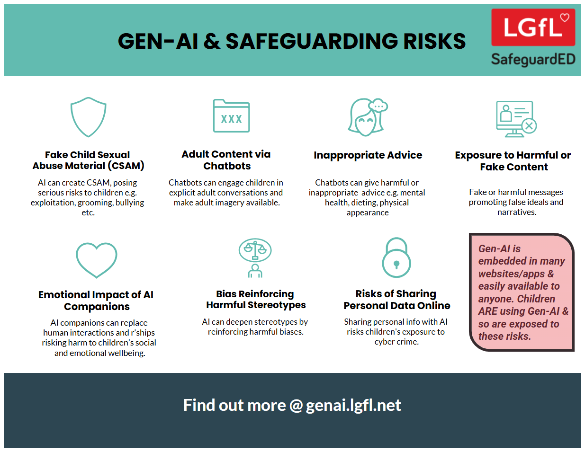
Notes:
Take them through some of the key points from this poster highlighting the safeguarding risks of Gen-AI

Slide 30
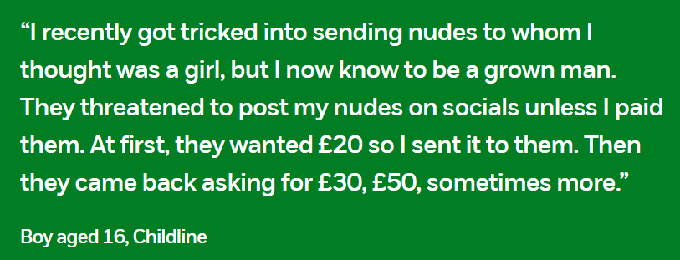
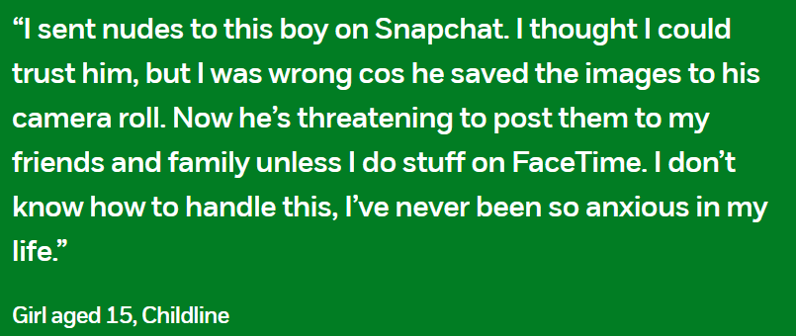
Financially Motivated Sexual Extortion – ‘SEXTORTION’
NSPCC (2024) Young people’s experiences of online sexual extortion or ‘sextortion’. London: NSPCC.
Notes:
EXPLAIN – it is a type of online blackmail involving an adult offender posing as a young person, threatening to release nude or semi-nude images and/or videos of a child or young person, unless they pay money. Victims of any age and gender can be targets - majority of cases have involved male victims aged 14-18
TELL - It’s important to remember that a child or young person is never to blame if they have been blackmailed online. Offenders will have tricked, groomed and/or manipulated them into sharing an image, or created digitally manipulated images of them. The reality is that it could happen to anyone.

Slide 31

Livestreaming
Sixteen per cent of children livestream their own videos
    3-9 year-olds (1 in 10)
    10-12 year-olds (2 – 10)
Why does this MATTER?
Source: Children and parents: media use and attitudes report 2025
Notes:
DISCUSS - Talk through the reasons why people live stream. E.g. Sharing videos instantly and live can feel exciting, showcase talents, campaign against issues, spontaneously share their thoughts with an audience, Show events like music concerts, tutorials e.g. putting on makeup
ASK – What do you think the risks are??
TELL: -
Live streaming presents a number of risks to children and young people which may be divided into whether the child or young person is viewing the live stream or is sharing/hosting the live stream.
Exposure to inappropriate or harmful content via live streaming.
Content can be uncensored and spontaneous.
Content can have a harmless title or description yet contain offensive or harmful content without the viewer realising.
Comments on live streams aren’t moderated and can be viewed by everyone, young people could see upsetting or harmful comments.
The host of the livestream might feel bullied or pressured to do something in the moment by comments from viewers that they might not feel comfortable doing.
Young people might feel more confident or comfortable sharing things online than they would offline.
Live streaming provides ease of access for perpetrators to engage with children and young people.
Viewers can also screen record or take screenshots of the live stream, even without the host’s consent.
2. Live streaming can facilitate sexual abuse in different ways
While any legitimate internet platform could be abused by offenders attempting to contact children, live streaming provides an ease of access through the instant, direct connection ‘viewers’ have to ‘hosts’ while watching live streams. Live streaming may therefore facilitate sexual abuse as offenders utilise live streams to groom and exploit children to undress or perform sexual acts.
Offenders may try to move the child away from the public stream to a one-on-one live streaming chat. Some offenders may capture videos/images of the child to store or distribute or use in further blackmail.
Software can be used to record the live streaming of child sexual abuse and/or still images can be captured of the child sexual abuse during the broadcast

Slide 32
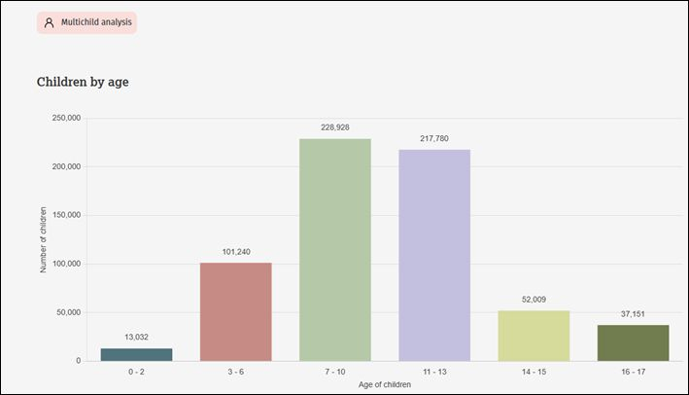


There were more 7-10-year-olds in child sexual abuse material (CSAM) images found by IWF than 11-13s in 2024
It can also affect younger children
Source: IWF Annual Data & Insights Report 2024, published April 2025
Notes:
TELL –
1. The Internet Watch Foundation are the only organisation other than law enforcement who can search for and remove child sexual abuse imagery.91% of all the content they remove of child sexual abuse material, is ‘self-generated’. Self-generated Child Sexual Abuse Material (CSAM) are images and videos which are taken by children and then shared either:
willingly, usually with a boyfriend/girlfriend, or
unwillingly, through coercion, or
shared by a third party without their consent.
Some of these images end up being distributed, sometimes sold, on the open and dark web by those with a sexual interest in children. Sadly, much of this takes place in home environments, where parents believe their children to be safe. But the internet allows people to access you child, unless you have appropriate controls and settings in place.
2. One of the biggest increases seen in the latest data, is the rise in the number of images found of 7-10 year olds. This may surprise some people, as there can be an assumption that this is an issue mainly affecting teenagers.
EXPLAIN - This is one of the reasons why we as schools and parents need to start the conversations as early as possible with children, and to be very considered about when children start using devices and controls around this.
NOTES –
7-10s highest group!!
7-10s and 11-13s remain the main groups
14-15 and 16-17 substantially creeping up over each of past three years, so don’t think ‘they’re growing out of it’

Slide 33
Being safer while live streaming
Talk to them about what they are sharing
Use devices in public spaces e.g. lounge not bedroom
Beware of VR interactions
Check privacy and safety settings on the app/site
Be wary of requests to chat in private
Know Support and Reporting functions
Notes:
Other tips to consider if you know your child live streams

Slide 34

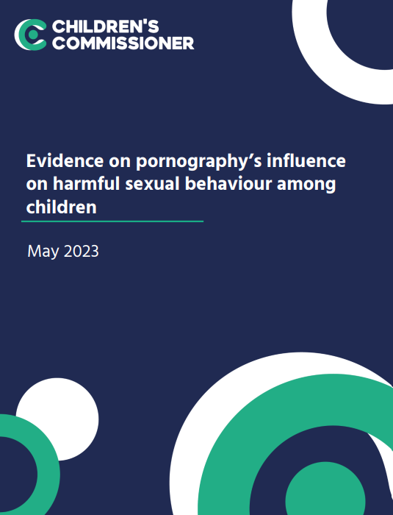
Pornography
Average age children first view pornography is 13
Substantial proportions viewed it at a much younger age – 27% by age 11 and 10% by the age of 9
Unbearable pressure to view hardcore pornography even if they do not want to
Degrading acts and violence against women
Think it is reflective of real life or healthy relationships
Pornography sites are not the only way, or even the most popular way, that young people access online porn
Wide prevalence of on social media platforms such as Twitter, Snapchat and Instagram
Would you know how to talk to your child about pornography?
Source: https://www.childrenscommissioner.gov.uk/resource/pornography-and-harmful-sexual-behaviour/
Notes:
TELL: Many children’s first exposure is accidental via social media or others showing them
SHARE: these tips on how to talk to your child about pornography - https://www.keepitrealonline.govt.nz/parents/pornography

Slide 35
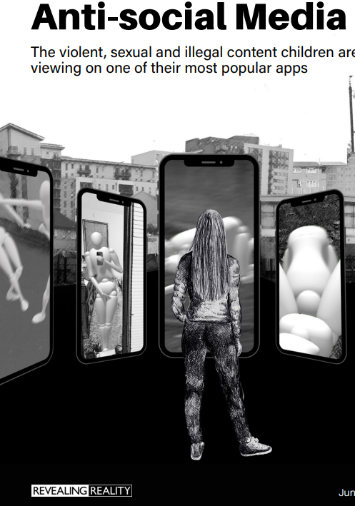
Snapchat: ‘It’s our evening news…’
Disturbing, graphic and illegal content:
  Fights / beatings / stabbings / raids
  Sexual assaults, sex acts involving children, CSAM
  Sale of weapons and drugs online
  (Some see this type of content several times a day, daily)
Wouldn’t consider reporting – seen what happens to a ‘grass’
While other children use Snapchat’s built-in filters to add funny effects to their selfies, the filter these children experience is the normalisation of humiliation, aggression, violence and crime
Source: Revealing-Reality: Anti-social-Media Report 2023
Notes:
Revealing Reality did this research to explore what some vulnerable children are seeing and doing on their phones
TELL - They’re not viewing this content on the dark web, finding it buried on hard-to-reach websites or through clandestine underground networks. They see it on mainstream social media and messaging platforms, primarily on Snapchat.

Slide 36
Remember!
Before signing up to any app/site
check that your child meets the minimum age requirement
Remind your child to be cautious about accepting friend requests:
a real friend is someone they/you know in real life, not a ‘friend’ they met gaming or in a chat room.
Stress the importance of not sharing personal information with online ‘friends’
Keep passwords confidential
Check their privacy settings
emphasise the importance of not sharing personal information with strangers
Report any content
e.g. a post, image or harmful, misleading or damaging comment
Reporting doesn't guarantee immediate removal
platforms assess reported content based on their rules and policies

Slide 37

Echo chambers create misinformation, reinforce stereotypes and distort one’s perspective, making it harder to consider opposing viewpoints
Social media can act as an ‘echo chamber’ - a place where individuals find their ideas supported and echoed by other like-minded individuals
A filter bubble is
a type of echo chamber created by algorithms that keep track of what you click on
Websites use algorithms to show content similar to what you’ve already selected. This can prevent you from finding new ideas and perspectives online
Sharing things that appeals to others in echo chambers makes it more popular and spread faster – even if it isn’t true!
And makes it easier to confirm existing beliefs

Slide 38



What can you do about filter bubbles?
Look at things in context
Look for evidence to separate facts from opinion
Question what you come across and consider other points of view
Follow accounts you might not always agree with, so algorithms can show you a variety of viewpoints
Only share something if you’re certain
Just because you WANT it to be true, doesn’t mean it is!

