Slide 1

Mastering Number at Home
Year 1
If you could take some time to complete our questionnaire, whilst waiting we would be very grateful, as it will help us to monitor the impact of this project.
It can be found on Classdojo.
Many thanks
https://forms.gle/YXNzFemeXkHHQu3z6

Slide 2
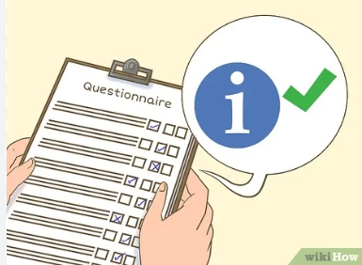
If you could take some time to complete our questionnaire, we would be very grateful, as it will help us to monitor the impact of this project.

Slide 3
Aims of the session
Share with you some of the things your child will be learning in school
Improve your confidence in helping your child with maths
Create some games and activities for use at home
Share with you the home learning activities

Slide 4
Resources you should find in your pack:
Year 1
14 double-sided counters
Homework Diary
Week 1 activity sheet
2 dice frames
The digit cards for 6
You will also need an egg box for 6 eggs

Slide 5
Aims of the session
Share with you some of the things your child will be learning in school
Improve your confidence in helping your child with maths
Create some games and activities for use at home
Share with you the home learning activities

Slide 6
Why engage you in your child’s learning?
Research evidence suggests that when parents are engaged in their children’s learning, outcomes for children can be improved.
Research also highlights the fact that parents feel they need more support to understand the current curriculum content and how they can support their child with their learning at home.
Desforges, C. and Abouchaar, A. (2003); Goodall, J. and Vorhaus, J. (2011);
The Education Endowment Foundation (2019); Sarjeant, S. (2021)

Slide 7
BBC News Report 2006
69% of parents do not help children with their homework because…
Everything has changed since they were at school and they are not confident in the new methods.
BBC News Report 2010
Lots of initiatives were introduced, despite this, the situation worsened! By 2010 82% of parents feel unable to help pupils with their homework.

Slide 8
In the Impact in Learning maths programme, children regularly talked about the clash between the maths learnt in school and what parents were showing them at home.
The ‘problem’ with maths
That’s not the way we do it in school!
“My dad thinks that the way he does maths is easier and better than my way but he doesn’t understand my way and his way confuses me.”
Pupil – Catford High School

Slide 9




How does Mastering Number help us to teach maths in school?
The MN Programme is a new national programme based on research into what is important in early maths education.
The Mastering Number Programme in Year 1 will help your child to develop good number sense.
Some of the things they are learning include:
Know different ways to ‘make’ (compose) a number
Recognising small numbers of objects without having to count them
Notes:
.

Slide 10

How does knowing how numbers are ‘made’ help children?
The numbers that the children use may be smaller than what they can do at home, but we are purposefully focusing on smaller numbers so that the children can develop a deep understanding of numbers to develop that good number sense an d be able to apply this in their future learning.
I know that 6 is made of 4 and 2 so I will also know...
6 - 2
60 - 20
40 + 20
400 + 200
0.4 + 0.2
0.6 - 0.2

Slide 11
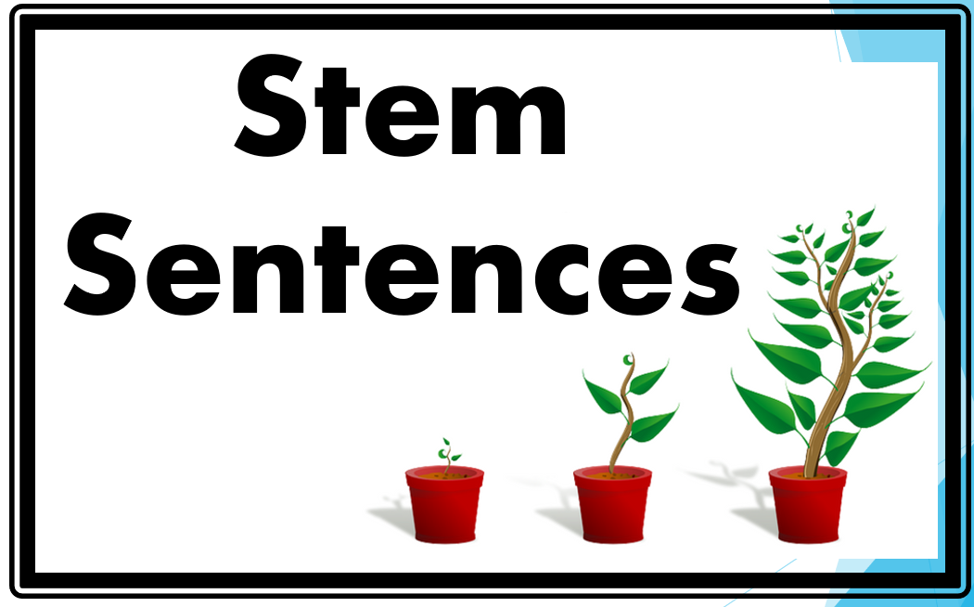
Language development: The way that children speak and write about mathematics has been shown to have an impact on their success.
In school we use stem sentences to improve mathematical thinking and communication skills. They can help children to:
build a deeper understanding of mathematical concepts,
visualize problems before they move on to more abstract concepts,
break down problems into smaller chunks,
encourage the children to use mathematical vocabulary to discuss and explain their ideas and reasoning.
STEM SENTENCES USED IN SCHOOL
What do you notice?
If I know… then I know…’
What’s the same? What’s different?
Tell me more.../Talk me through what you did
Convince me that you are right/ Is this the only answer/ Is there another way of working out the answer?
Which is the odd one out? Explain why?
Spot the error/ ‘What’s wrong with this?’

Slide 12


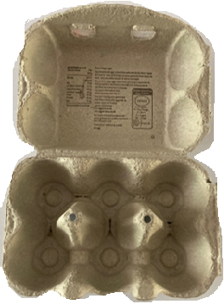
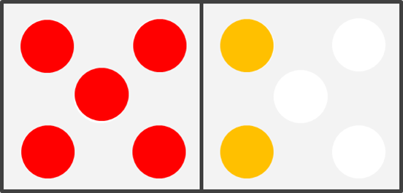
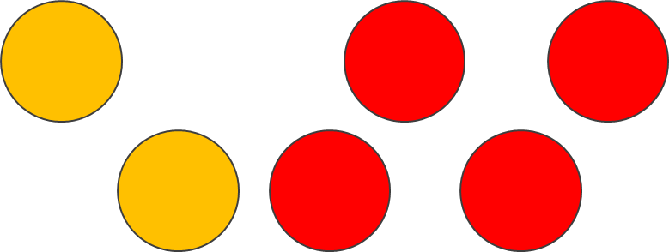
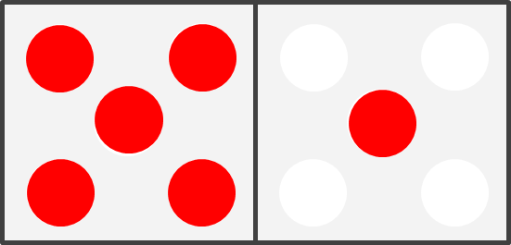
Let’s look at 6 and 7!
Finding all the ways that 6 and 7 are ‘made’ and then doing activities that give them a chance to practise will help children.

Slide 13

Recognising small ‘numbers’
For all of the activities you will be doing at home, we want children to use a special skill called ‘subitising’.
Get your fast eyes ready!
Show on your fingers and tell your grown-up how many dots you can see!

Slide 14
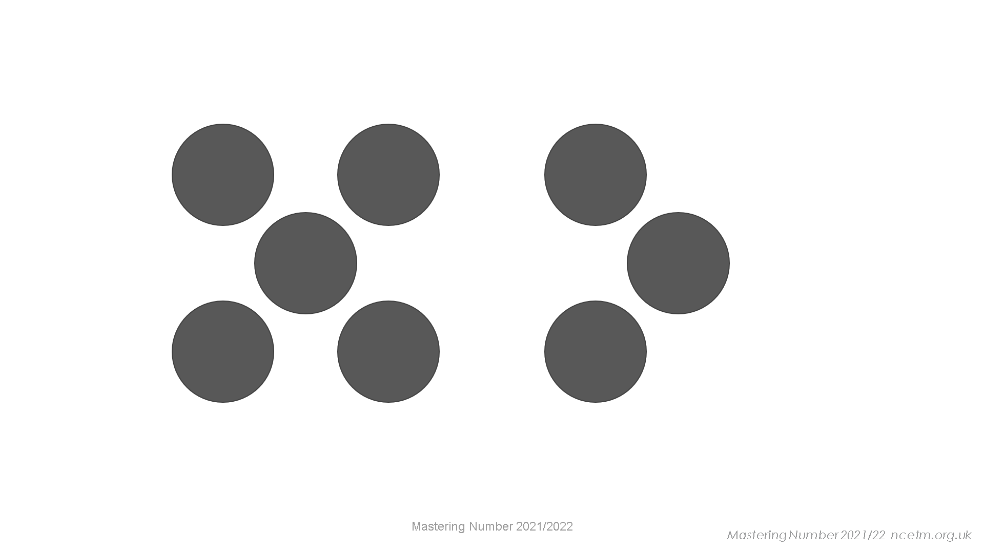

Slide 15
Notes:
Did you need to count?

Slide 16
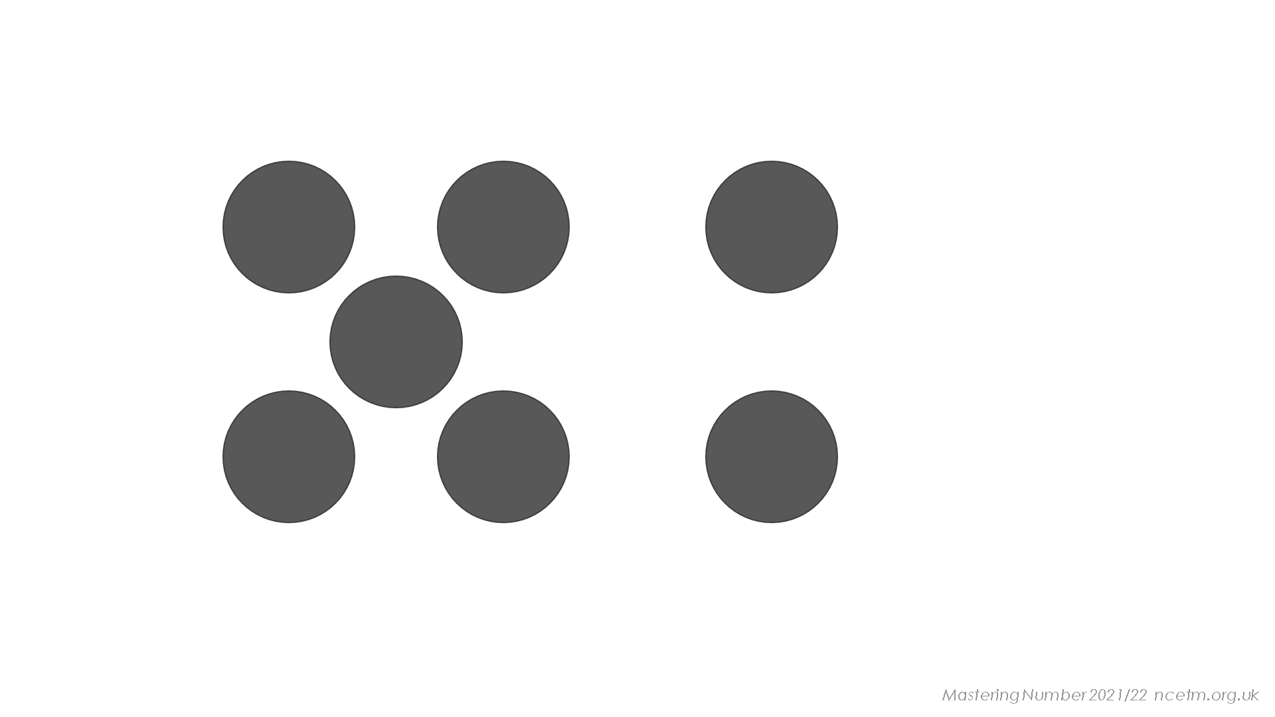
Notes:
What helps you to see four here?
Tell your grown-up where you have seen this four before.

Slide 17
Mastering Number 2021/22 ncetm.org.uk

Slide 18
How you know that this is five?

Slide 19
What helps you to see six here?
The dice representations are a useful support that children become used to recognising. However, it’s also important that they can recognise the amounts when they are not in the dice patterns.

Slide 20
Home learning tasks
Each week, you will be given a sheet that explains some activities that children can do with their grown-up.
In Year 1, the tasks will all be about finding ways to make 6 and 7, but these tasks could be used for other numbers later on.
In all of the tasks, children should be encouraged to ‘see’ the amount of objects without counting – just as they did in the previous activity.

Slide 21
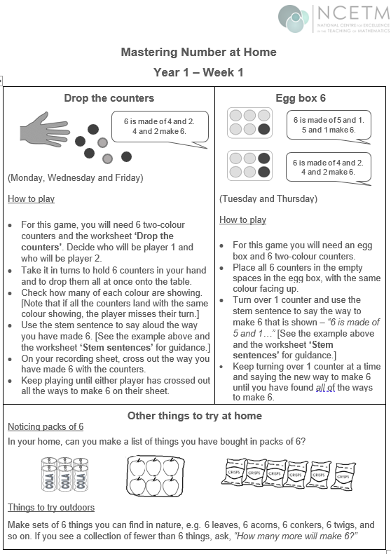

Let us take a look at some of the activities involved in the project.
The home learning sheet and diary asks you to complete certain activities on certain days. Try to keep to this if possible, but if you have to move days around due to other commitments, that is fine.
We understand that children have clubs and activities which may mean they have to ‘miss’ certain days, in these cases we are asking you to complete the tasks at the weekend instead- it is only 10 minutes a day! ☺
Where possible, we would like families to stick to the order of the homework exercises. The additional activities are optional. The might be attempted on the same day, or at the weekend, depending on time.

Slide 22
Play ‘Drop the counters’
Remember to use the stem sentence!
They are not just there as a prompt for the children; there is evidence to show that when
The children should subitising the sub-groups/ i.e. how many of each colour.
You will need 6 double-sided counters to play.
6 is made of _____ and _____;
_____ and _____ make 6.
Week 1

Slide 23
6 is made of _____ and _____;
_____ and _____ make 6.
6 is made of 4 and 2;
4 and 2 make 6!
Play ‘Drop 6 counters’ with a grown up! How quickly can you say what you see?
Grown ups: Model what your bond to show your child how to use the stem sentence
Mastering Number 2021/22 ncetm.org.uk

Slide 24
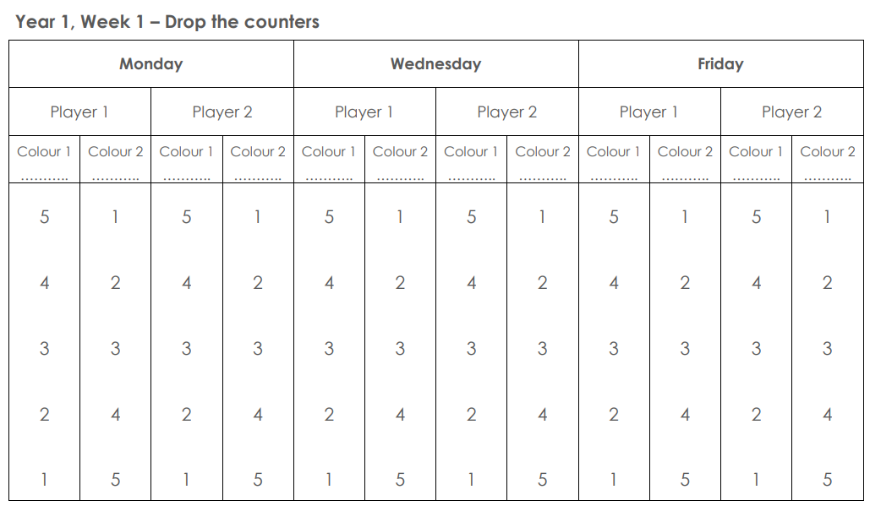
red yellow
Week 1

Slide 25
Play ‘Egg Box 6’ with counters
Use your stem sentence strip again, this time using your egg box and counters.
6 is made of _____ and _____;
_____ and _____ make 6.
Week 1

Slide 26
Let’s work systematically or in order to find the ways to make 6.
6 is made of _____ and _____;
_____ and _____ make 6.

Slide 27
Place all counters red side up
How many yellow counters?
How many red counters?
We are going to work systematically to find all the ways that 6 can be composed, using the counters.

Slide 28
Turn over one counter at a time so you can see the yellow side
6 is made of 1 and 5;
1 and 5 make 6!
6 is made of _____ and _____;
_____ and _____ make 6.
Notes:
.

Slide 29
6 is made of _____ and _____;
_____ and _____ make 6.

Slide 30
6 is made of _____ and _____;
_____ and _____ make 6.

Slide 31
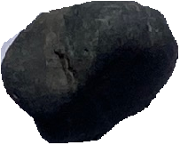
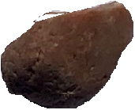
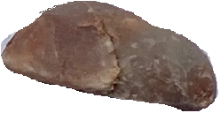
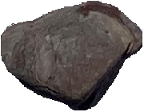
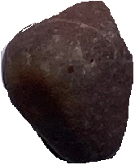
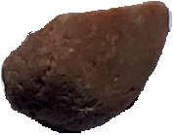
Play ‘Egg Box 6’ with objects
Gather 6 objects that can fit in the spaces in the egg box.
Week 2

Slide 32
Put some of the objects in the egg box and hide the others.
How many more to make 6?
_____ needs _____ to make 6.

Slide 33
Play this again using different numbers of objects.
_____ needs _____ to make 6.

Slide 34
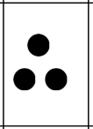
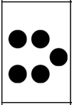
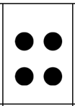
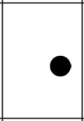

Find pairs to 6 with dots
Cut out the cards and place them face UP on the table in front of you.
Week 2.

Slide 35
Play: ‘Find pairs to 6’ with dot cards
Let’s practise remembering the ways that 6 can be made.
Week 2
Mastering Number 2021/22 ncetm.org.uk

Slide 36
Find pairs that make 6.
One person will pick up a card, and the other person must pick up the card that will ‘make 6’.
Use the stem sentence to support.
_____ needs _____ to make 6.
Week 2: In Week 4, children will find pairs of numbers that make 7 with dots.

Slide 37

Play ‘Copy my 7’
You will need two of these for this activity.
Week 3

Slide 38
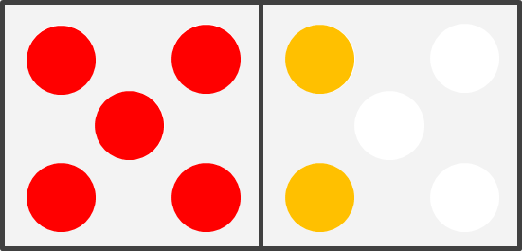
Grown-ups: make this arrangement and briefly show it to your child.
Children: can you copy the arrangement exactly?
You may wish to start with fewer counters (5) if your child finds this challenging.

Slide 39
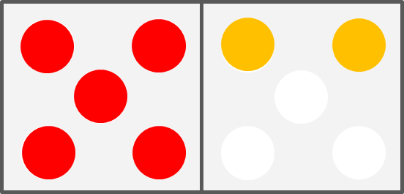

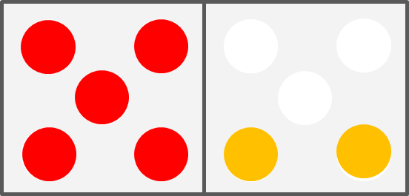
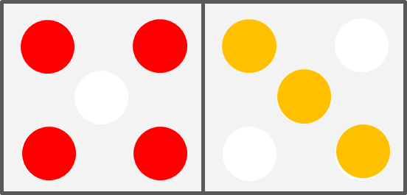
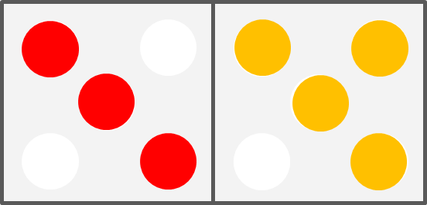
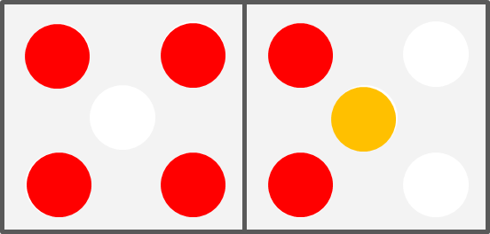
Now try some of these arrangements.
Can your child have a ‘quick peep’ at your counters and place their counters in exactly the same place as yours?
Be careful to consider perspectives here – can the child see the counters in the same orientation as the grown-up? They may need to move their seat to do so.

Slide 40
Play ‘Make it 7’
You will need 10 counters altogether.
Grown-ups – Place some counters (up to 5) on one side of the frame.
Children – place counters on the other side to make 7.
Week 4

Slide 41
Play ‘Make it 7’
Each player needs to have some double-sided counters (up to 10 each).
One player should put some counters down on the table.
The second player needs to make 7 by adding the correct number of counters. Can you do it without counting?
Use the stem sentence to say how many more makes 7.
Week 4

Slide 42
Play ‘Make it 7’
Play a game of ‘Make it into 7’ with a partner!
That’s 4! I think 4 needs… 3 to make 7!
_____ needs _____ to make 7.
Mastering Number 2021/22 ncetm.org.uk

Slide 43
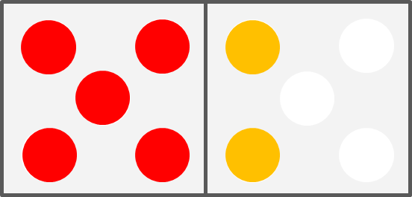
Subitising – 6 or 7
By the end of the five weeks, your children might well be able to subitise patterns with counters and say whether there are 6 or 7.
Week 5

Slide 44
Home Learning
You are going to take all the games we made today home with you to practise.
The home learning for this week is set out on a sheet with instructions. You will receive a new sheet and some new activities each week.
We anticipate each day that you will do ten minutes of activity. Sometimes it may not take 10 minutes which is fine – maybe you could try some of the additional activities on those days.

Slide 45
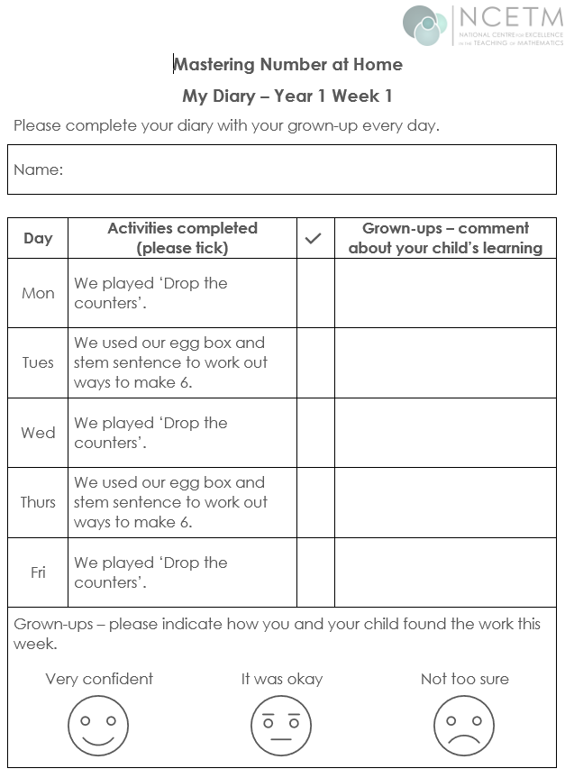
We are asking the grown-ups to play the games on the days indicated on the sheet, although there is flexibility on this and some could be done at the weekend.
We do not want you to spend more than 10 minutes each day on this. It can also be shared by family members and doesn’t have to be done with the person who attends the workshop.
Please tick when an activity has been completed. There is no need write comments (unless you really want to!) Please also indicate how confident your child was with the tasks.
Played with dad. Sam was able to say see all the parts of 7.

Slide 46
If you could take some time to complete our post-workshop questionnaire, we would be very grateful, as it will help us to monitor the impact of this project.
https://forms.gle/VdFWHQGTMrZxR9To9

Slide 47

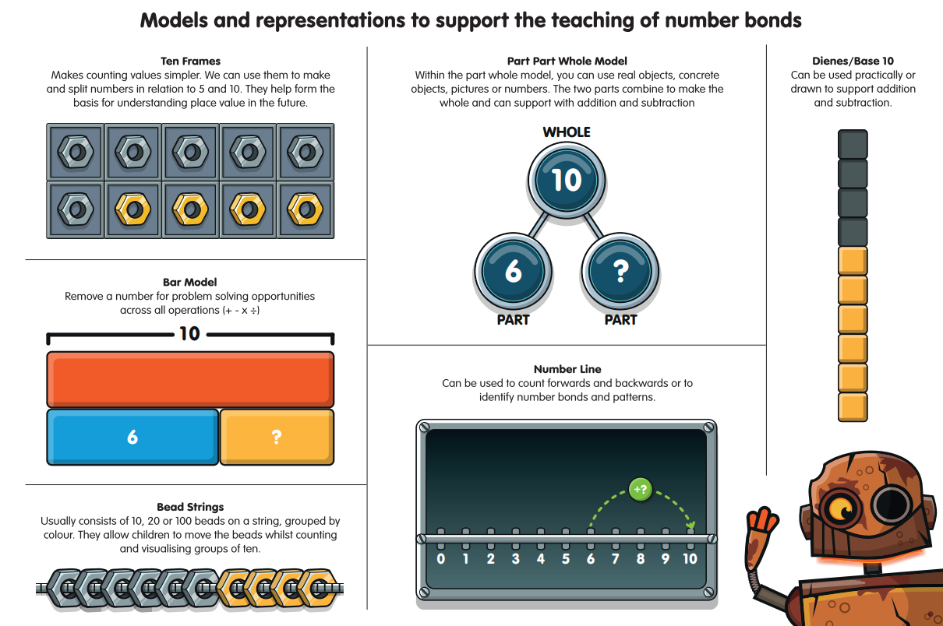
https://youtu.be/24sqgVgwBOg

Slide 48
References:
Axford, N., Berry, V., Lloyd, J., Moore, D., Rogers, M., Hurst, A., Blockley, K., Durkin,H. and Minton, J. (2019) How Can Schools Support Parents’ Engagement in their Children’s Learning? Evidence from Research and Practice. London: Education Endowment Foundation.
Desforges, C. & Abouchaar, A. (2003), The impact of parental involvement, parental support and family education on pupil achievement and adjustment: A literature review. London: Department for Education and Skills.
Goodall, J & Vorhaus, J (2011), Review of Best Practice in Parental Engagement. Department for Education.
Sarjeant, S (2021) Engaging parents in children’s literacy: an investigation into the Impact in Writing programme as a strategy for parental engagement. Available at: https://orca.cardiff.ac.uk/id/eprint/136692/3/1576474%20Suzanne%20Sarjeant%20-%20Final%20thesis%20(002).pdf (Accessed 03.10.2022)

Slide 49
Thank you!

