Slide 1

Mastering Number at Home
Year 2
If you could take some time to complete our questionnaire, whilst waiting we would be very grateful, as it will help us to monitor the impact of this project.
It can be found on Classdojo.
Many thanks
https://forms.gle/YXNzFemeXkHHQu3z6

Slide 2
Resources you should find in your pack:
Year 2
20 double-sided counters
Homework Diary
Week 1 activity sheet
5 and a bit cards
10-frames and dice frames sheet
Shows 7/Does NOT show 7 table
A3 version of Odd and even numbers on a 10-frame

Slide 3
Aims of the session
Share with you some of the things your child will be learning in school
Improve your confidence in helping your child with maths
Create some games and activities for use at home
Share with you the home learning activities

Slide 4
Why engage you in your child’s learning?
Research evidence suggests that when parents are engaged in their children’s learning, outcomes for children can be improved.
Research also highlights the fact that parents feel they need more support to understand the current curriculum content and how they can support their child with their learning at home.
Desforges, C. and Abouchaar, A. (2003); Goodall, J. and Vorhaus, J. (2011);
The Education Endowment Foundation (2019); Sarjeant, S. (2021)

Slide 5
BBC News Report 2006
69% of parents do not help children with their homework because…
Everything has changed since they were at school and they are not confident in the new methods.
BBC News Report 2010
Lots of initiatives were introduced, despite this, the situation worsened! By 2010 82% of parents feel unable to help pupils with their homework.

Slide 6
In the Impact in Learning maths programme, children regularly talked about the clash between the maths learnt in school and what parents were showing them at home.
The ‘problem’ with maths
That’s not the way we do it in school!
“My dad thinks that the way he does maths is easier and better than my way but he doesn’t understand my way and his way confuses me.”
Pupil – Catford High School

Slide 7




How does Mastering Number help us to teach maths in school?
The MN Programme is a new national programme based on research into what is important in early maths education.
The Mastering Number Programme in Year 2 will help your child to develop good number sense.
Some of the things they are learning include:
Know different ways to ‘make’ (compose) a number
Recognising small numbers of objects without having to count them
Notes:
.

Slide 8

How does knowing how numbers are ‘made’ help children?
The numbers that the children use may be smaller than what they can do at home, but we are purposefully focusing on smaller numbers so that the children can develop a deep understanding of numbers to develop that good number sense an d be able to apply this in their future learning.
If I know that 8 is made of 5 and 3, I will also know...
8 – 3 = 5
5 + 3 = 8
80 – 30 = 50
50 + 30 = 80
0.5 + 0.3 = 0.8
500 + 300 = 800
0.8 – 0.3 = 0.5

Slide 9

Language development: The way that children speak and write about mathematics has been shown to have an impact on their success.
In school we use stem sentences to improve mathematical thinking and communication skills. They can help children to:
build a deeper understanding of mathematical concepts,
visualize problems before they move on to more abstract concepts,
break down problems into smaller chunks,
encourage the children to use mathematical vocabulary to discuss and explain their ideas and reasoning.
STEM SENTENCES USED IN SCHOOL
What do you notice?
If I know… then I know…’
What’s the same? What’s different?
Tell me more.../Talk me through what you did
Convince me that you are right/ Is this the only answer/ Is there another way of working out the answer?
Which is the odd one out? Explain why?
Spot the error/ ‘What’s wrong with this?’

Slide 10
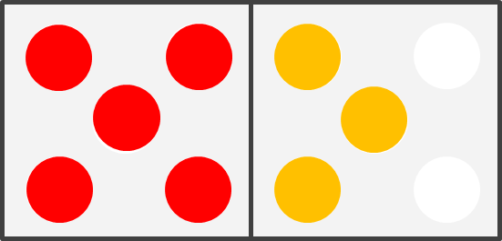
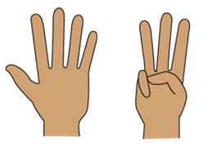
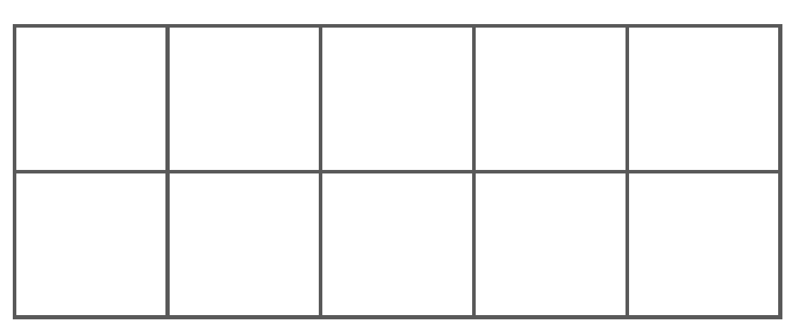
Looking at the numbers 6, 7, 8 and 9
Children will learn that these numbers all have 5 ‘inside them’, as well as seeing all the ways they can be made.
The 5 and a bit strategy.
We always start with 5.
We then consider the ‘bit’ that has been added on to 5 to make a larger number. 6 is a little bit and 9 is a big bit.
This helps children to see the relationships between the numbers and how they link to both 5 and 10 (using the gaps to bridge to 10).
I know that 8 is made of 5 and 3.

Slide 11
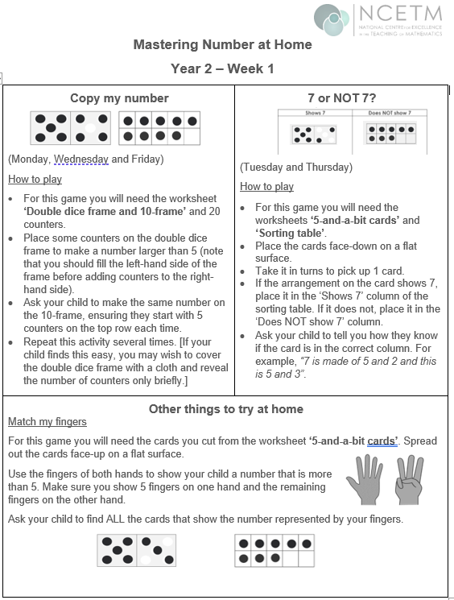

Let us take a look at some of the activities involved in the project.
The home learning sheet and diary asks you to complete certain activities on certain days. Try to keep to this if possible, but if you have to move days around due to other commitments, that is fine.
We understand that children have clubs and activities which may mean they have to ‘miss’ certain days, in these cases we are asking you to complete the tasks at the weekend instead- it is only 10 minutes a day! ☺
Where possible, we would like families to stick to the order of the homework exercises. The additional activities are optional. The might be attempted on the same day, or at the weekend, depending on time.

Slide 12
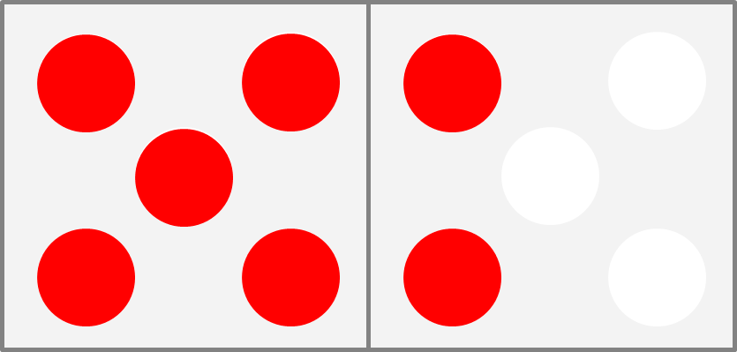
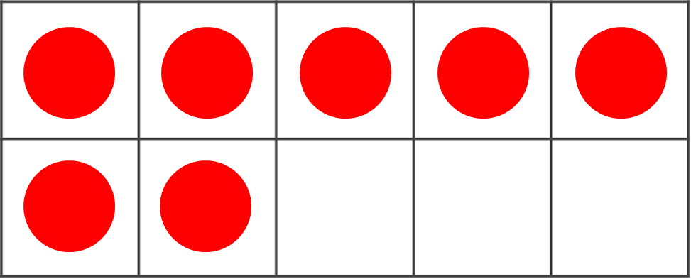
Play ‘Copy my number’
_____ is made of 5 and _____.
5 and ____ make _____.
Grown-ups: place 7 counters on the dice frame as shown.
Children: can you make the same number on the 10 frame showing it as ‘5 and a bit’?
Possible questions to ask:
Can you see the two on the dice frame?
Where is the two on the 10 frame? What is the same? What is different?
Can your child do it when you hide the dice frame after showing them once?
‘Close your eyes and visualise what you saw…’
Now try again for 8 and 9.
Week 1

Slide 13
Play ‘Shows 7 / Does not show 7’
Week 1
Sort the cards:
Shows 7 | Does NOT show 7
Ask your child:– why do these cards NOT show 7?
Allow them to reason: 7 is made of 5 and 2 and this card only has 5 and 1.
We don’t just want children to say, ‘because it is 6.’
Research show that if they can reason about when an amount is not a given number, they are more able to reason about when it is.

Slide 14
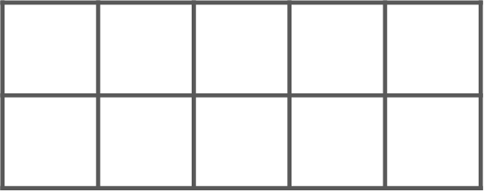
Play ‘Match my fingers’
Week 1: ‘Other things to try at home’
Grown-ups: use your fingers to show a number between 5 and 9.
Children: can you find four cards that show the same number?
MAKE SURE THAT ONE HAND IS SHOWING 5.
Knowing that the numbers are a bit more than 5 and a bit less than 10 means that we think of the numbers relationally.
8 is made of 5 and 3. It is also 2 less than 10.

Slide 15
Play ‘Ways to make 10’ It is important that children are aware of all of the numbers that are parts of 10.
You will need your 10 frame and 10 counters.
It is important that children are aware of all of the numbers that are parts of 10.
Week 2

Slide 16
Start at the bottom and place two at a time.
Children: Place the counters on the 10-frame so they are all red.

Slide 17
Grown-ups: turn one counter over at a time.
Say the stem sentence together.
10 is made of ____ and ____.
____ and ____ make 10.

Slide 18
Keep saying the stem sentence together.
10 is made of ____ and ____.
____ and ____ make 10.

Slide 19
Working in a systematic way like this helps children to see the relationship between the numbers and to explore all the possible ways to make 10.
Continue doing this until all the counters are yellow.
10 is made of ____ and ____.
____ and ____ make 10.

Slide 20
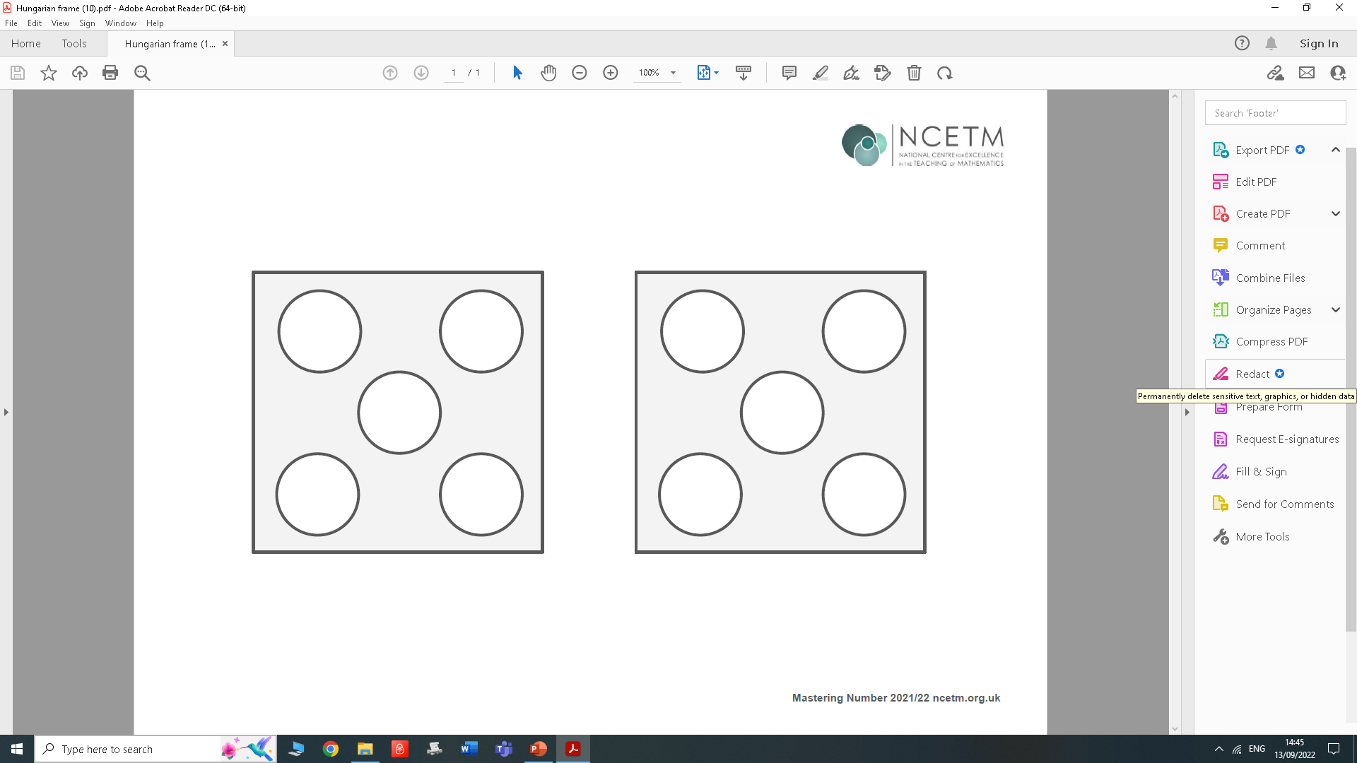
Play ‘How many more to make 10?’
Now you will need your dice frame and 10 counters.
Week 2

Slide 21
Grown-ups: Place 7 red counters onto the dice frame, using the ‘5 and a bit’ pattern.
Children: Fill the spaces with yellow counters and use the stem sentence.
10 is made of _____ and _____.
_____ and _____ make 10.

Slide 22
Grown-ups: Repeat using a different ‘5 and a bit’ number (e.g. 6, 8 or 9).
10 is made of _____ and _____.
_____ and _____ make 10.
In Week 3, children will be asked to say how many are needed to make 10 without filling the spaces.
You could make this harder by making the arrangements less obvious, e.g. so there are empty spaces on both sides of the dice frame.

Slide 23
Week 2
You could play the same game using the 10-frame – this might be more tricky!
10 is made of _____ and _____.
_____ and _____ make 10.

Slide 24
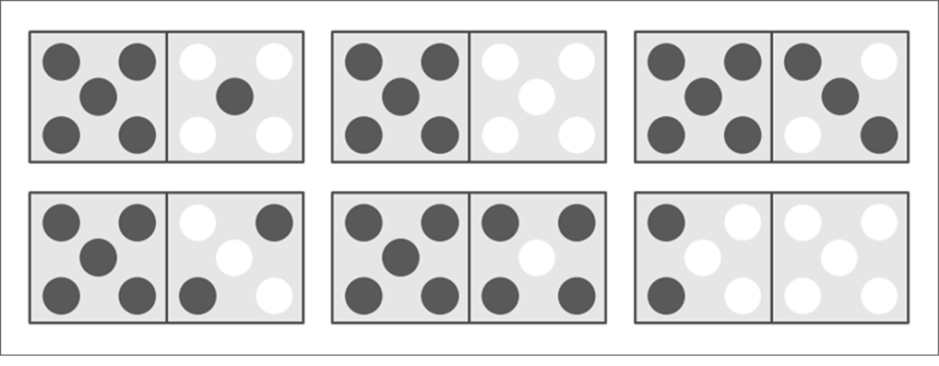
Introducing ‘Make it 10 Bingo’
Player 1: pick a caller card and read it out
Player 2: find the number that makes 10 and cover it with a counter.
What does 4 need to make 10?
_____ needs _____ to make 10.
Week 3

Slide 25
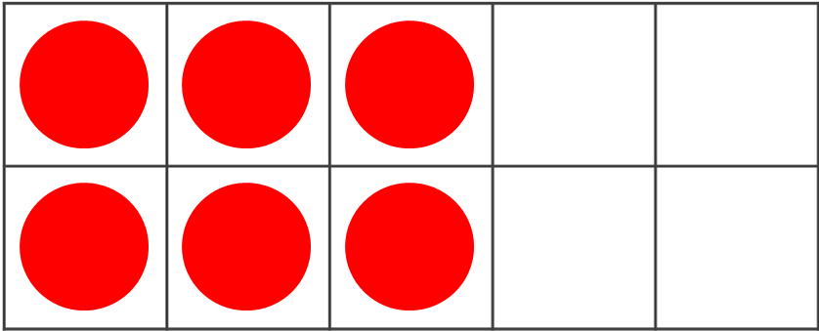


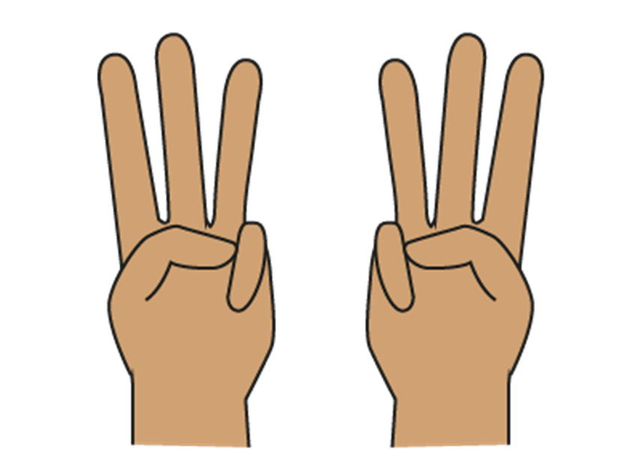

Week 4
Odd and even numbers ‘inside’ other numbers
Let’s think about the odd and even parts of numbers.
We want children to understand that even numbers can be made of 2s, and can be made with 2 equal parts, i.e. doubles.
We also want children to recognise that even numbers can be composed from 2 odd parts or 2 even parts. Knowing this will help them reason about calculations involving odd and even numbers.

Slide 26
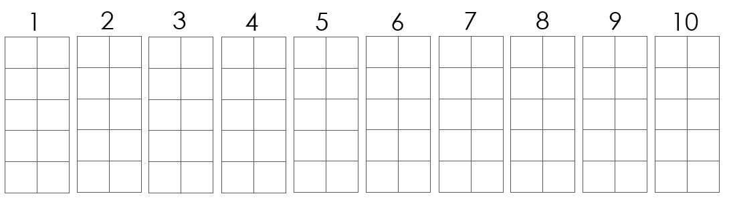
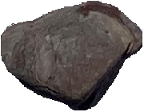
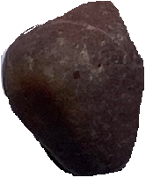
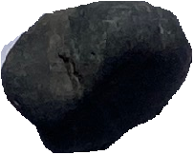
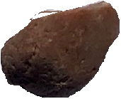
Use your objects to show the numbers on the 10-frames.
Place them in the order shown.
Possible questions to use:
Do they (the objects) all have partners?
Can you see the shape of four has ‘flat top’ in the 10-frame?
What do you notice about 5?
Can you see the odd one that gives 5 an odd top?
Can you predict whether the next number will be odd or even?
What do you notice about the pattern that is being made by 4 or 5 objects?
Week 4

Slide 27
Play ‘Drop 10 counters’
Try to subitise – but it might be tricky depending how they land!
Maybe one part can be subitised, and children can try and remember the other parts – they may need to check by counting!
This will help children practise remembering the ways to make 10, but add in the challenge of identifying whether the parts are odd or even.
How many of each colour? Are the parts odd or even?
You will need 10 double-sided counters to play.
Week 4

Slide 28
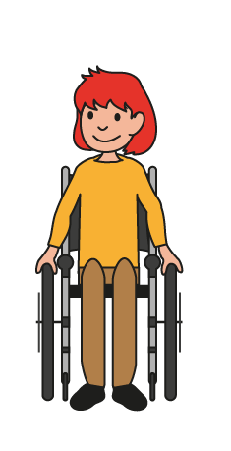
Play ‘Ways of making 7 and 8’
Can you see if 7 can be made of odd or even parts?
6 + 1
5 + 2
4 + 3
3 + 4
2 + 5
1 + 6
Week 5

Slide 29
Can you see if 8 can be made of odd or even parts?
7 + 1
What do you notice about the parts that make 8?
(They can be odd and odd or even and even. They can’t be odd and even.) We are prompting a generalisation here.
Week 5

Slide 30
Home Learning
You are going to take all the games we made today home with you to practise.
The home learning for this week is set out on a sheet with instructions. You will receive a new sheet and some new activities each week.
We anticipate each day that you will do ten minutes of activity. Sometimes it may not take 10 minutes which is fine – maybe you could try some of the additional activities on those days.

Slide 31
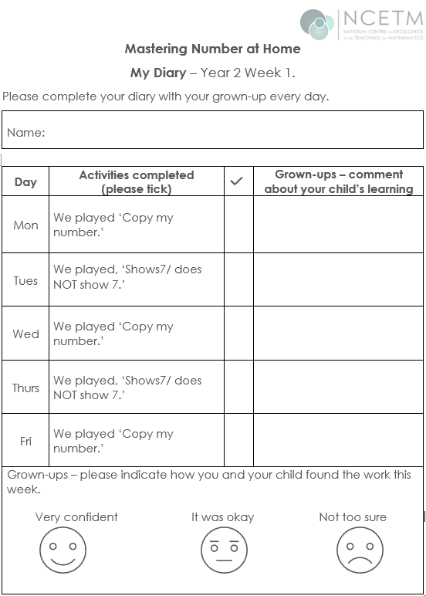
We are asking the grown-ups to play the games on the days indicated on the sheet, although there is flexibility on this and some could be done at the weekend.
We do not want you to spend more than 10 minutes each day on this. It can also be shared by family members and doesn’t have to be done with the person who attends the workshop.
Please tick when an activity has been completed. There is no need write comments (unless you really want to!) Please also indicate how confident your child was with the tasks.
Joe was able to copy all the numbers I showed.
√

Slide 32
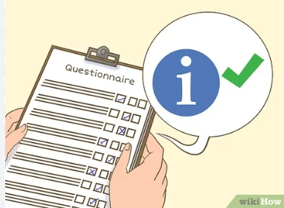
If you could take some time to complete our post- questionnaire, we would be very grateful, as it will help us to monitor the impact of this project.
https://forms.gle/VdFWHQGTMrZxR9To9

Slide 33

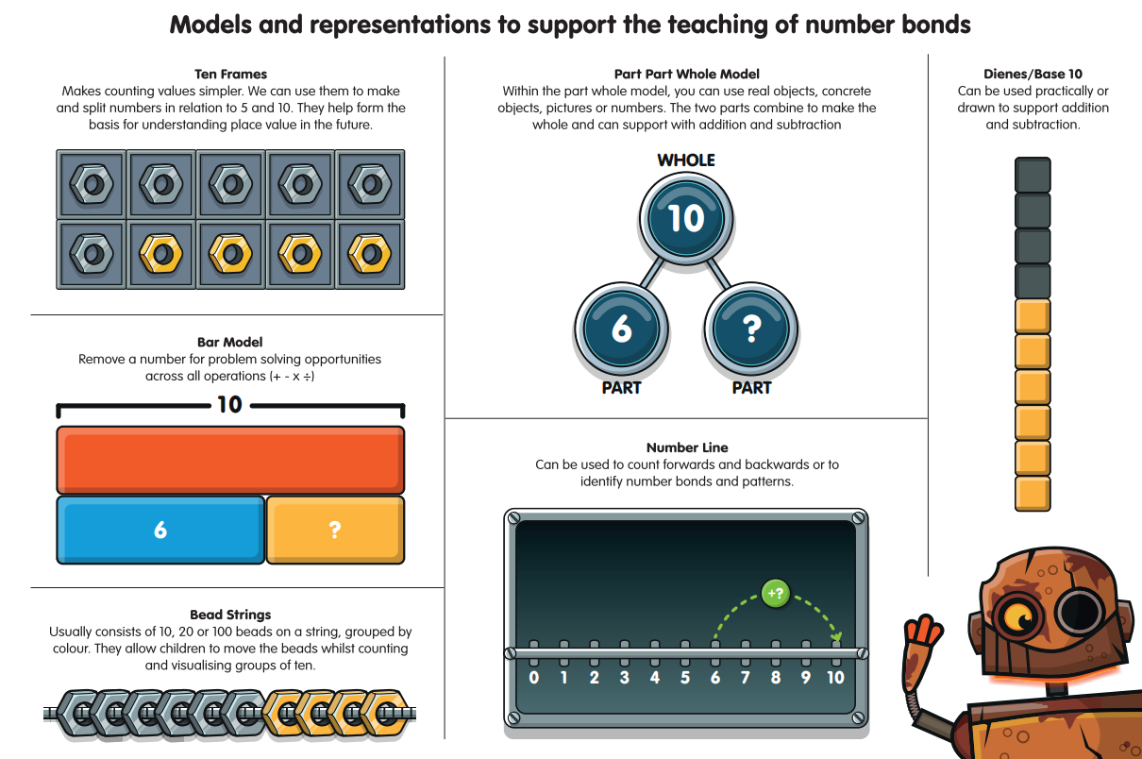
https://youtu.be/24sqgVgwBOg

Slide 34
References
Axford, N., Berry, V., Lloyd, J., Moore, D., Rogers, M., Hurst, A., Blockley, K., Durkin,H. and Minton, J. (2019) How Can Schools Support Parents’ Engagement in their Children’s Learning? Evidence from Research and Practice. London: Education Endowment Foundation.
Desforges, C. & Abouchaar, A. (2003), The impact of parental involvement, parental support and family education on pupil achievement and adjustment: A literature review. London: Department for Education and Skills.
Goodall, J & Vorhaus, J (2011), Review of Best Practice in Parental Engagement. Department for Education.
Sarjeant, S (2021) Engaging parents in children’s literacy: an investigation into the Impact in Writing programme as a strategy for parental engagement. Available at: https://orca.cardiff.ac.uk/id/eprint/136692/3/1576474%20Suzanne%20Sarjeant%20-%20Final%20thesis%20(002).pdf (Accessed 03.10.2022)

Slide 35
Thank you

