Slide 1

Mastering Number at Home
Reception
If you could take some time to complete our questionnaire, whilst waiting we would be very grateful, as it will help us to monitor the impact of this project.
It can be found on Classdojo.
Many thanks
https://forms.gle/YXNzFemeXkHHQu3z6

Slide 2
Resources you should find in your pack:
Reception
6 double-sided counters
Homework Diary
Week 1 activity sheet
‘Subitising to 3 Snap’ cards
‘Part–part–whole game’ cards
‘Frogs on a log’ worksheet

Slide 3
Aims of the session
Share with you some of the things your child will be learning in school
Improve your confidence in helping your child with maths
Create some games and activities for use at home
Share with you the home learning activities

Slide 4
Why engage you in your child’s learning?
Research evidence suggests that when parents are engaged in their children’s learning, outcomes for children can be improved.
Research also highlights the fact that parents feel they need more support to understand the current curriculum content and how they can support their child with their learning at home.
Desforges, C. and Abouchaar, A. (2003); Goodall, J. and Vorhaus, J. (2011);
The Education Endowment Foundation (2019); Sarjeant, S. (2021)

Slide 5
BBC News Report 2006
69% of parents do not help children with their homework because…
Everything has changed since they were at school and they are not confident in the new methods.
BBC News Report 2010
Lots of initiatives were introduced, despite this, the situation worsened! By 2010 82% of parents feel unable to help pupils with their homework.

Slide 6
In the Impact in Learning maths programme, children regularly talked about the clash between the maths learnt in school and what parents were showing them at home.
The ‘problem’ with maths
That’s not the way we do it in school!
“My dad thinks that the way he does maths is easier and better than my way but he doesn’t understand my way and his way confuses me.”
Pupil – Catford High School

Slide 7





How does Mastering Number help us to teach maths in school?
The MN Programme is a new national programme based on research into what is important in early maths education.
The Mastering Number Programme in Reception will help your child to develop good number sense.
Some of the things they are learning include:
Recognising small numbers of objects without having to count them
Know different ways to ‘make’ (compose) a number
Counting
Notes:
.

Slide 8

Let’s do some maths with the children!
Look out for when you can use your subitising skills! Get those fast eyes ready!

Slide 9
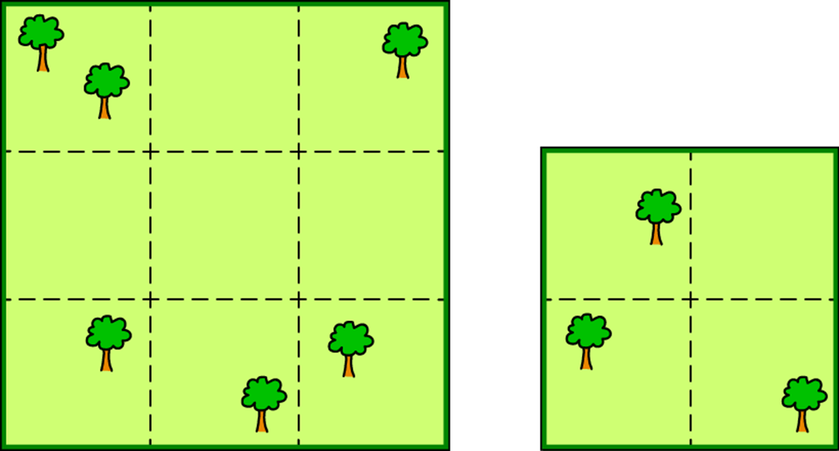

Slide 10


Slide 11
Why was that harder?
There were too many for our brains to recognise instantly (or subitise).
Let’s try again…
This time, can you show me on your fingers as well as saying the number?

Slide 12
How many were there this time?
What helped?
Seeing the pattern in the shape of the die face is something that can support subitising.

Slide 15
Subitising
Subitising is the ability to recognise a small quantity of objects without the need to count.
Sometimes when we subitise we can see two groups at once; if we know that 3 can be ‘made’ of 2 and 1, then we know how many there are altogether without counting.
Research shows that for very small quantities/numbers, this is an innate skill – we are born with this ability (although obviously the number words need learning!)
It is a really important skill that we can build on and will help children build number sense that they can use for maths later on in school.
Seeing the number of objects in lots of different ways (arrangements) supports children’s maths later on.

Slide 16

How does knowing how numbers are ‘made’ help children?
The numbers that the children use may be smaller than what they can do at home, but we are purposefully focusing on smaller numbers so that the children can develop a deep understanding of numbers to develop that good number sense an d be able to apply this in their future learning.
I know that 6 is made of 4 and 2 so I will also know...
6 - 2
60 - 20
40 + 20
400 + 200
0.4 + 0.2
0.6 - 0.2

Slide 17
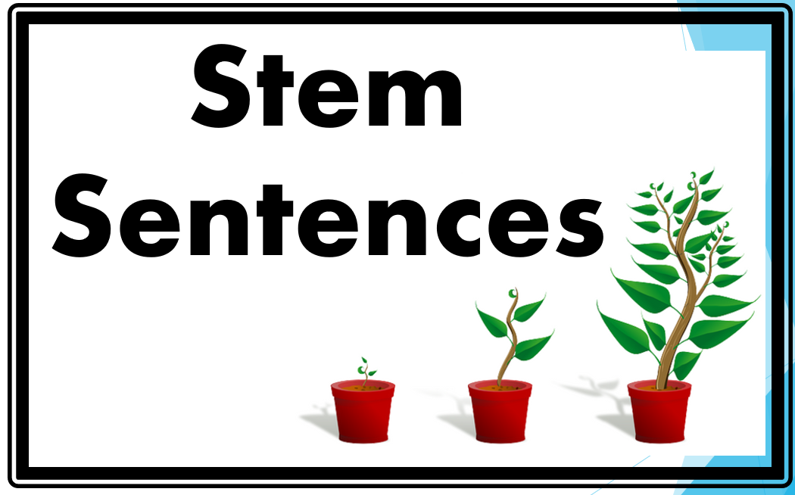
Language development: The way that children speak and write about mathematics has been shown to have an impact on their success.
In school we use stem sentences to improve mathematical thinking and communication skills. They can help children to:
build a deeper understanding of mathematical concepts,
visualize problems before they move on to more abstract concepts,
break down problems into smaller chunks,
encourage the children to use mathematical vocabulary to discuss and explain their ideas and reasoning.
STEM SENTENCES USED IN SCHOOL
What do you notice?
If I know… then I know…’
What’s the same? What’s different?
Tell me more.../Talk me through what you did
Convince me that you are right/ Is this the only answer/ Is there another way of working out the answer?
Which is the odd one out? Explain why?
Spot the error/ ‘What’s wrong with this?’

Slide 18
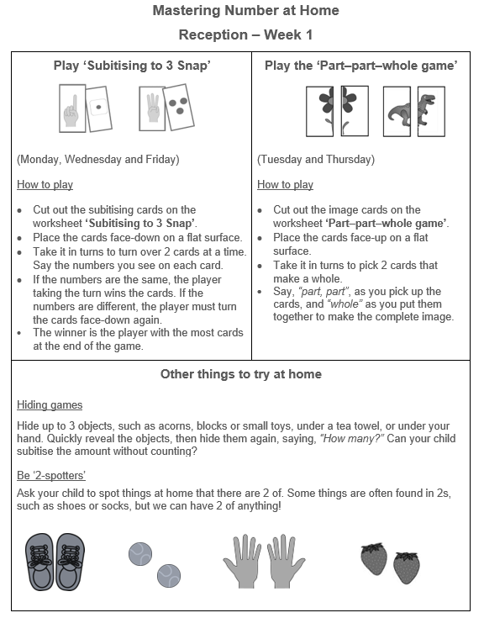

Let us take a look at some of the activities involved in the project.
The home learning sheet and diary asks you to complete certain activities on certain days. Try to keep to this if possible, but if you have to move days around due to other commitments, that is fine.
We understand that children have clubs and activities which may mean they have to ‘miss’ certain days, in these cases we are asking you to complete the tasks at the weekend instead- it is only 10 minutes a day! ☺
Where possible, we would like families to stick to the order of the homework exercises. The additional activities are optional. The might be attempted on the same day, or at the weekend, depending on time.

Slide 19
Play ‘Subitising to 3 snap’
Don’t count, say the amount!
Week 1

Slide 20
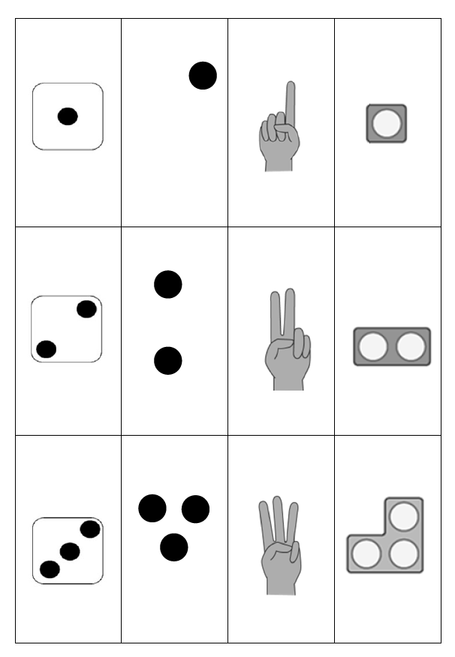
Grown-ups:
Please cut these into 12 separate cards and hand them to your child.
Children:
Please spread the cards out and place them face-down in front of you. (Ask the grown-up for help if unsure).

Slide 21
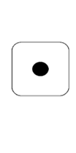

Take turns to turn two cards over and say the number you can see.
If the numbers do not match, place them back and try to remember where they are in case you need them later.

Slide 22


When it is your turn, if you turn over two cards that are the same, you can keep them.
The winner is the person with the most cards when they are all used up.
In Weeks 3 and 5, you will receive extra cards to practise subitising with bigger numbers. Don’t throw your cards away!
Can you show the number on your fingers?
Children may count to three on their fingers in Week 1, but could show you three straight away later on. Encourage children (after they have counted three) to look at their fingers, fold them down again, and then see if they can raise them again – all at the same time.
There are two ways to approach the game. If preferred, instead of having a winner, it might be better to work collaboratively to see if the grown-up/child can find all the pairs together.

Slide 23

Be careful we don’t assume children know what we mean!
Play ‘Part-part-whole’
A ‘whole’ donut?
The ‘hole’ in the donut?
Week 1
Notes:
Be careful we don’t assume children know what we mean!

Slide 24
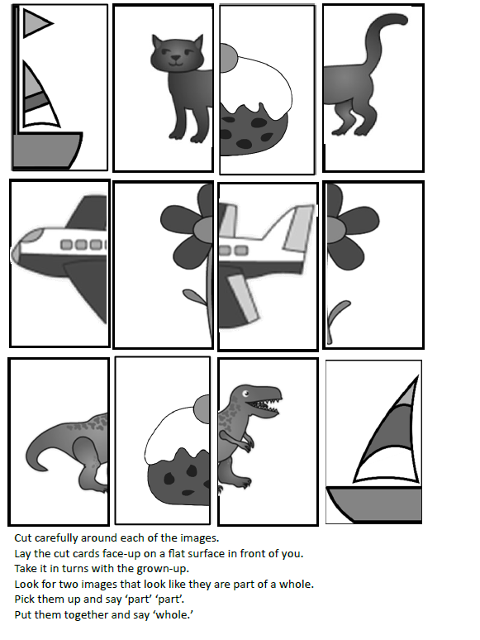
Find 2 parts that make a whole.
Grown-ups will need to carefully cut out these cards.
Children: place the cards face-up so you can see the pictures and spread the cards out in front of you.

Slide 25

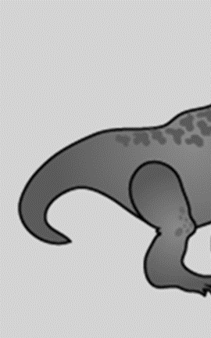
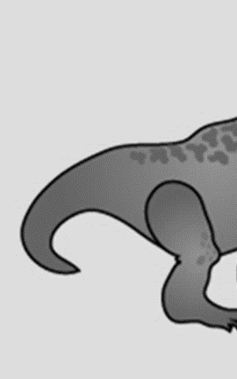

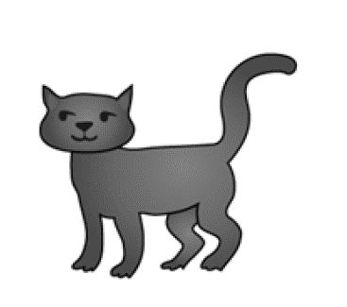

Can you see two parts that make a whole image?

Slide 26
Pick up each piece and say: ‘part… part…’
It is important to model the ‘part’ ‘part’ ‘whole’ talk

Slide 27
Now put them together and say: ‘whole!’
Can you find all the ‘wholes’ by doing the same?

Slide 28


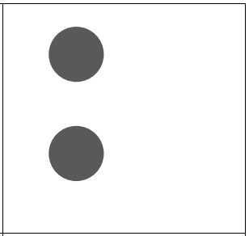
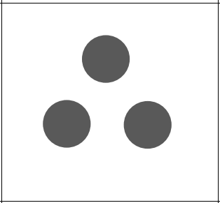

Part-part-whole with dots
Now we move on to seeing a set of objects as a ‘whole group’ and seeing some of the objects as ‘part of the whole’ and seeing both parts at the same time as the whole.
What we are asking children to do is really important in terms of developing their understanding of the concept of numbers being made up of other numbers.
In Week 3, you will play ‘part-part-whole’ with dots.
One person will pick up a card, and the other person must pick up the card that will ‘make 4’.

Slide 29
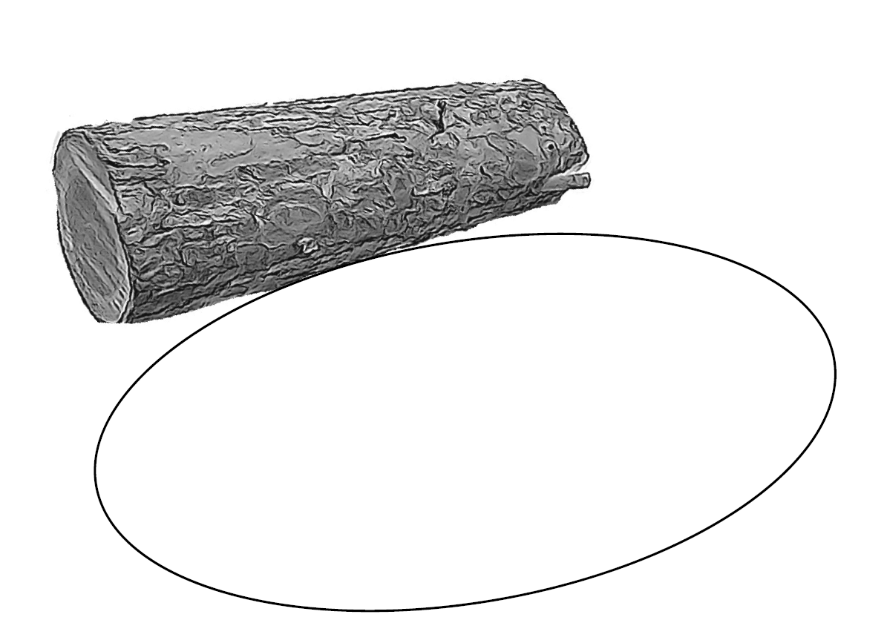
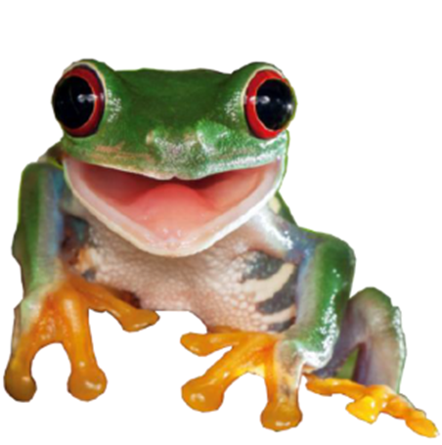
Play ‘3 frogs on a log’
The frogs on a log sheet
You will need...
3 frogs (counters)
Week 2

Slide 30


You will also need to show the numbers on your fingers!

Slide 31
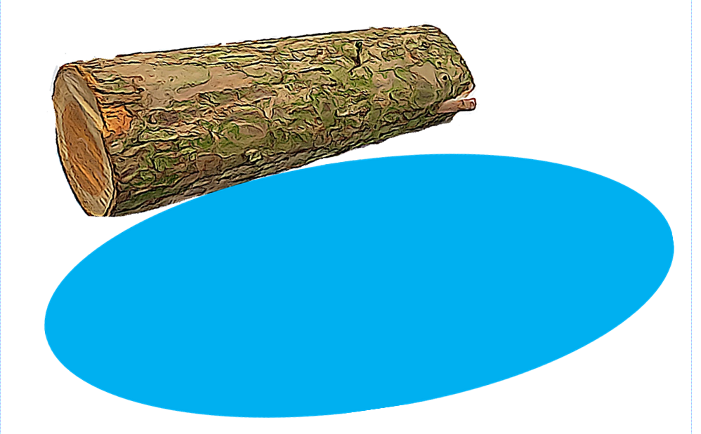
Put 3 frogs on the log
Ask your child
Show with your fingers:
How many are on the log?
How many in the pool?
How many altogether?
There are different ways to do it (children may show three middle fingers of one hand, or two fingers and a thumb) – that’s what deep understanding is.

Slide 32
Ask your child
Put 1 frog in the pool.
Is it still three?
Show with your fingers:
How many are on the log?
How many in the pool?
How many altogether?

Slide 33
Put another frog in the pool.
Ask your child
Is it still three?
Show with your fingers:
How many are on the log?
How many in the pool?
How many altogether?

Slide 34
Put another frog in the pool.
Ask your child
Is it still three?
Show with your fingers:
How many are on the log?
How many in the pool?
How many altogether?

Slide 35
In Week 4, you will play this game again with 4 frogs… or even 5!

Slide 36
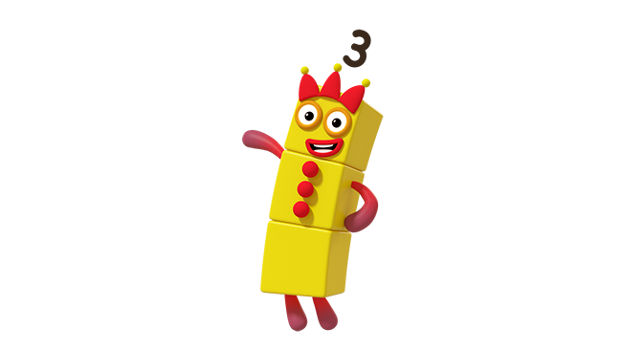
Week 2 (Image © Alphablocks)
Play ‘3 or NOT 3?’
This activity involves spotting when there are 3 of an object or explaining why there are NOT 3.
Mathematical talk is really important and talking about the smaller numbers will help children later on as they will feel more confident talking about numbers.

Slide 37
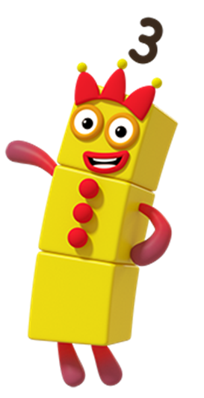
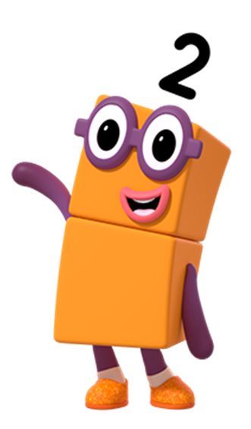


Put your thumb UP if you can see 3, and down if it is NOT 3.
(Image © Alphablocks)

Slide 38
Mastering Number 2021/22 ncetm.org.uk

Slide 39
We need to emphasise here that the focus is not on telling the child (or getting the child to tell us) what the number is … Only to say that it is NOT 3.
We want to encourage verbal responses, like: ‘I know it’s not three because it needs 1 more’
Mastering Number 2021/22 ncetm.org.uk

Slide 40
Mastering Number 2021/22 ncetm.org.uk

Slide 41
Mastering Number 2021/22 ncetm.org.uk

Slide 42
Mastering Number 2021/22 ncetm.org.uk

Slide 43
Mastering Number 2021/22 ncetm.org.uk

Slide 44
Mastering Number 2021/22 ncetm.org.uk

Slide 45
Mastering Number 2021/22 ncetm.org.uk

Slide 46
Mastering Number 2021/22 ncetm.org.uk

Slide 47
Mastering Number 2021/22 ncetm.org.uk

Slide 48
Mastering Number 2021/22 ncetm.org.uk

Slide 49
Mastering Number 2021/22 ncetm.org.uk

Slide 50
Mastering Number 2021/22 ncetm.org.uk

Slide 52
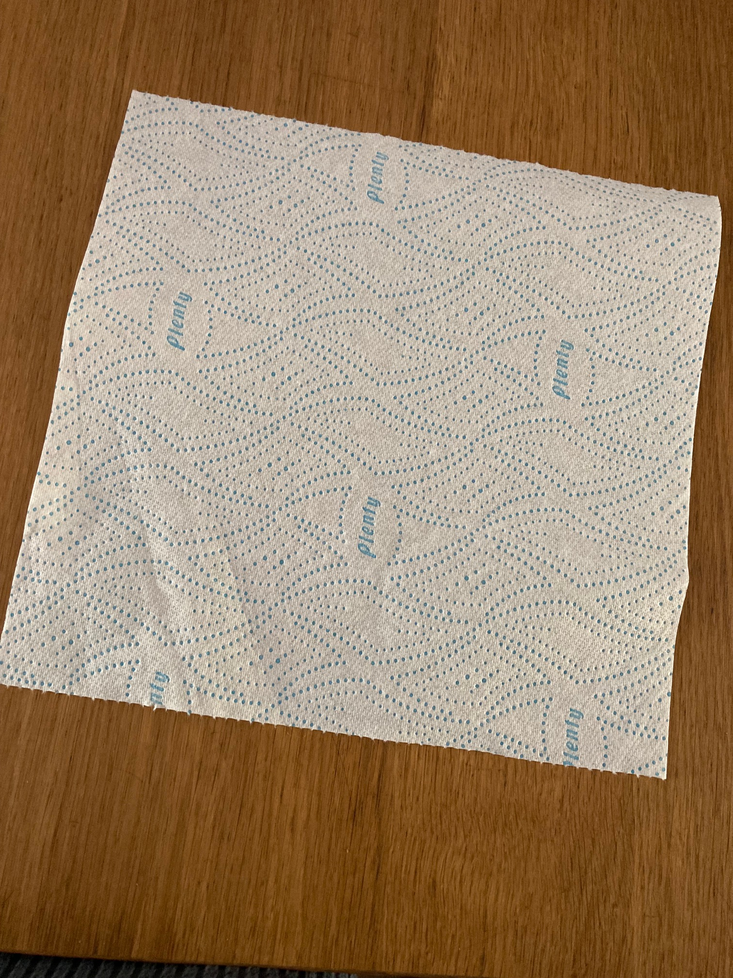
Play ‘3 or NOT 3?’ with counters
You will need 5 counters and something to cover them.

Slide 53
Grown-ups, hide some counters under the towel.

Slide 54
Reveal them quickly and ask your child…
3 or not 3?
We don’t want to focus on what the number IS – just whether it is 3 or NOT.
We will talk about why we know it is not 3 at the end of the game.
Remember do not to say ‘it is three’ but to say ‘it is not 3.’

Slide 55
In Week 4, you will try this with different numbers…
4 or not 4?

Slide 56
Now ask: ‘What do you need to do to make it 3?’
If I take 1 away it will make 3.
This is already 3!
I need to add 1 more to make 3.

Slide 57
Home Learning
You are going to take all the games we made today home with you to practise.
The home learning for this week is set out on a sheet with instructions. You will receive a new sheet and some new activities each week.
We anticipate each day that you will do ten minutes of activity. Sometimes it may not take 10 minutes which is fine – maybe you could try some of the additional activities on those days.

Slide 58
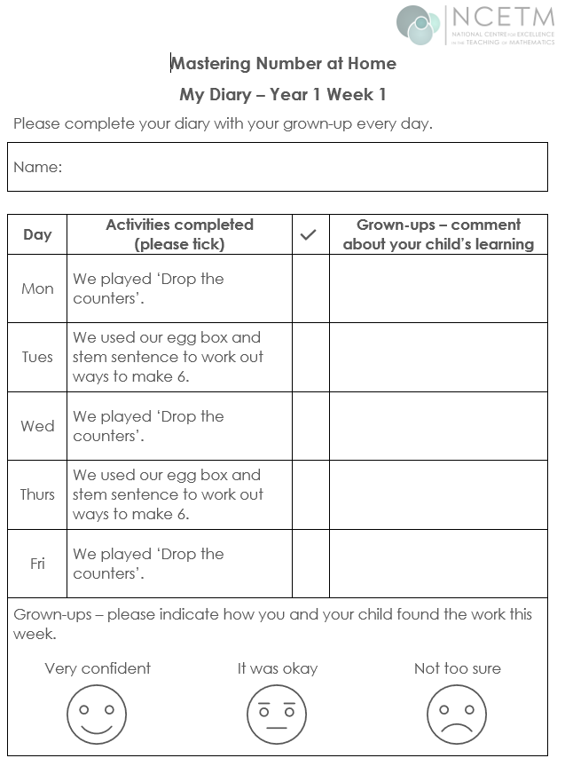
We are asking the grown-ups to play the games on the days indicated on the sheet, although there is flexibility on this and some could be done at the weekend.
We do not want you to spend more than 10 minutes each day on this. It can also be shared by family members and doesn’t have to be done with the person who attends the workshop.
Please tick when an activity has been completed. There is no need write comments (unless you really want to!) Please also indicate how confident your child was with the tasks.
Played with dad. Sam was able to say see all the parts of 7.

Slide 59
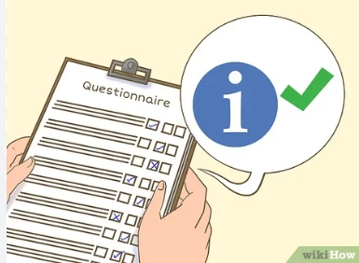
If you could take some time to complete our post-workshop questionnaire, we would be very grateful, as it will help us to monitor the impact of this project.
https://forms.gle/VdFWHQGTMrZxR9To9

Slide 60
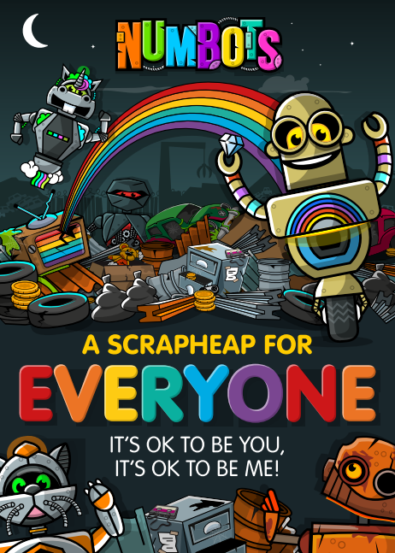
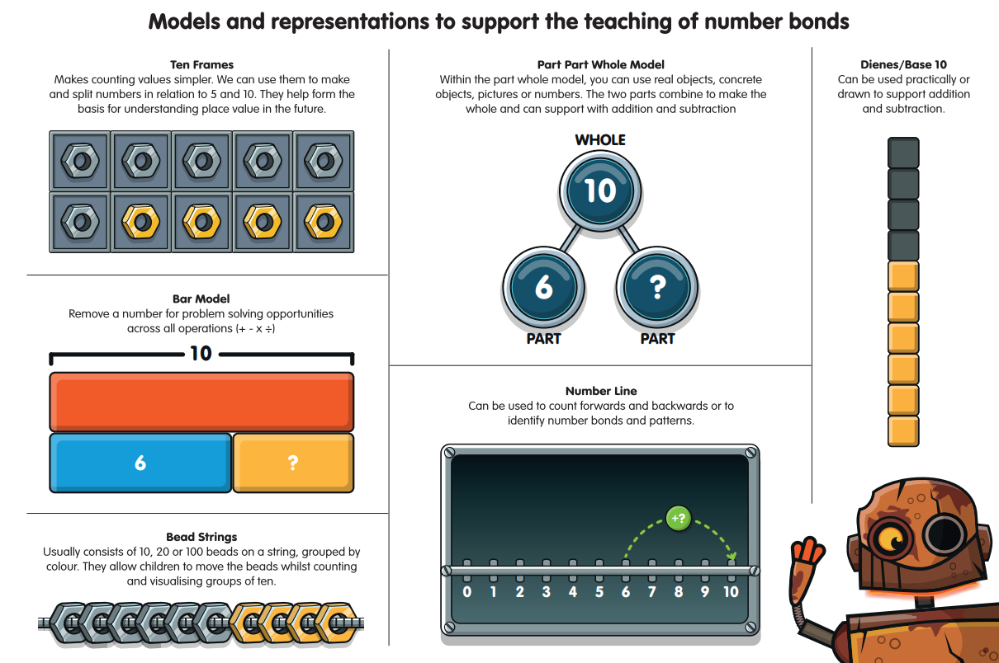
https://youtu.be/24sqgVgwBOg

Slide 61
References:
Axford, N., Berry, V., Lloyd, J., Moore, D., Rogers, M., Hurst, A., Blockley, K., Durkin,H. and Minton, J. (2019) How Can Schools Support Parents’ Engagement in their Children’s Learning? Evidence from Research and Practice. London: Education Endowment Foundation.
Desforges, C. & Abouchaar, A. (2003), The impact of parental involvement, parental support and family education on pupil achievement and adjustment: A literature review. London: Department for Education and Skills.
Goodall, J & Vorhaus, J (2011), Review of Best Practice in Parental Engagement. Department for Education.
Sarjeant, S (2021) Engaging parents in children’s literacy: an investigation into the Impact in Writing programme as a strategy for parental engagement. Available at: https://orca.cardiff.ac.uk/id/eprint/136692/3/1576474%20Suzanne%20Sarjeant%20-%20Final%20thesis%20(002).pdf (Accessed 03.10.2022)

Slide 62
Thank you!
Notes:
Ask if there are any questions. Parents can fill out the evaluation sheet for the session.

